Slide 1
WELCOME TO
PMI Training!
Scope Management Secrets
Day Two

Slide 2

Scope Management Secrets
The Heart of Project Management
DAY TWO
Brad Bigelow, PMP

Slide 3

Disclaimer
The views and opinions expressed in the following PowerPoint slides are those of the individual presenter.
These PowerPoint slides are protected under the copyright laws of the United States of America and other countries. Used by permission. All rights reserved. Project Management Institute and PMI are registered trademarks. All other trademarks are the property of their respective owners.
The PowerPoint slides are for registered attendees of the
PMI® SeminarsWorld®.
3

Slide 4
Day One Recap
Scope: The Basics
Scope: The Not-So-Basics
Digging Deeper into Scope
Why Scope is Fuzzy
Why Scope is Risky

Slide 5
Day Two Exercise Project:
Finance 26

Slide 6
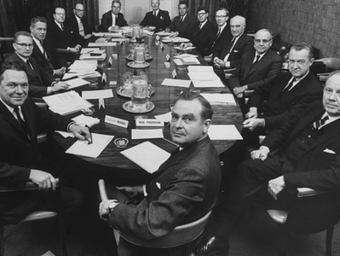
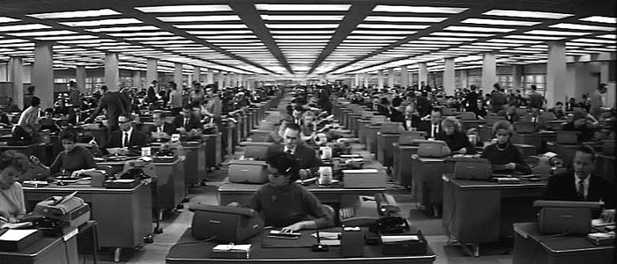
Acme Gadget Manufacturing Corporation (AGMC)
Family-owned, family-run
Founded in 1905
Plants in Canada and USA

Slide 7


eGadget
CEO-driven, virtual C-suite
Founded in 1995
Outsourced manufacturing

Slide 8
Day Two Exercise Project
As Is:
  Two financial management systems
  Three financial management units
To Be:
  One system
  Two locations/one organization

Slide 9
Scope Management through the Project Lifecycle
Before the Project
Initiation
Planning
Executing
Monitoring & Control
Closure
After the Project

Slide 10
SCOPE MANAGEMENT THROUGH THE LIFECYCLE
BEFORE THE PROJECT

Slide 11
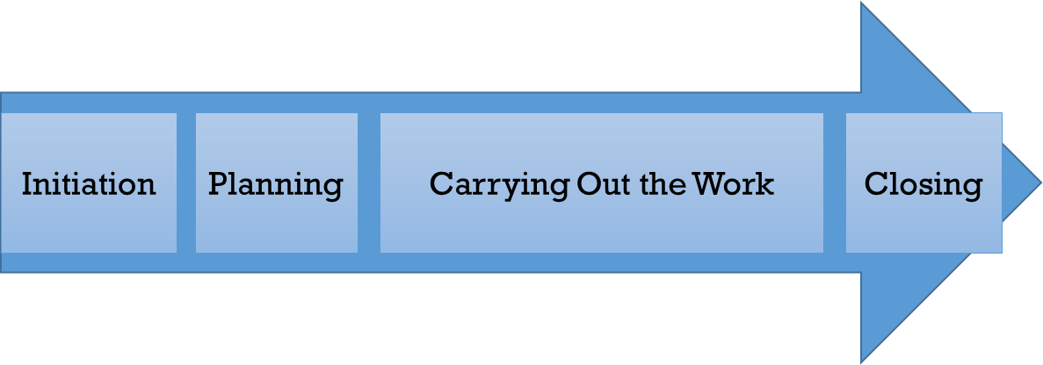
The Larger Life Cycle
What Happened in the Past
What Led to Project Initiation
What is Going On During the Project
What will Happen After the Project

Slide 12
The Larger Life Cycle
What Happened in the Past
What Led to Project Initiation
What is Going On During the Project
What will Happen After the Project
Enterprise Environmental Factors
  Organizational culture
  Infrastructure
  Personnel
  Market Forces
  Regulations
  Organizational Process Assets

Slide 13
The Larger Life Cycle
What Happened in the Past
What Led to Project Initiation
What is Going On During the Project
What will Happen After the Project
Organizational Strategy
Ongoing Operations

Slide 14
Project Initiation Context
Regulatory/Legal/
Social Requirements
Stakeholder Needs
One or More of These is the Source of the Project’s WHY
Create New Products, Processes or Services
Upgrade/Improve/
Refresh Existing Capabilities
Transformational Change

Slide 15
Project as Change Delivery
Organizational Strategy
New Business as Usual
Project
Business as Usual
Scope Management Secrets: Day Two

Slide 16
Project as Change Delivery
Why Do Projects Fail?
Organizational Strategy
New Business as Usual
Project
Business as Usual
Scope Management Secrets: Day Two

Slide 17
Project as Change Delivery
Organizational Strategy
New Business as Usual
Not Aligned to Strategy
Project
Business as Usual
Scope Management Secrets: Day Two

Slide 18
Project as Change Delivery
Organizational Strategy
New Business as Usual
Project
Business as Usual
Not Aligned to Business as Usual
Scope Management Secrets: Day Two

Slide 19
Project as Change Delivery
Organizational Strategy
New Business as Usual
Project
Fails through Internal Deficiencies
Business as Usual
Scope Management Secrets: Day Two

Slide 20
Project as Change Delivery
Organizational Strategy
New Business as Usual
Project
Fails to Produce Expected Results
Business as Usual
Scope Management Secrets: Day Two

Slide 21
Project as Change Delivery
Why Do Projects Succeed?
Organizational Strategy
New Business as Usual
Project
Business as Usual

Slide 22
Project success dimensions:
Kerzner (2009)
Within allocated time
Within budgeted cost
At the proper performance or specification level
With acceptance by customer
With minimum or mutually agreed scope changes
Without disturbing the main flow of work of the organization
Without changing the corporate culture
Lechler and Dvir (2010)
On schedule
On budget
Met specifications
Improve performance
Used by customers
Positive impact
Satisfied customers
Perceived as an Economic success

Slide 23
Project success dimensions:
Kerzner (2009)
Within allocated time
Within budgeted cost
At the proper performance or specification level
With acceptance by customer
With minimum or mutually agreed scope changes
Without disturbing the main flow of work of the organization
Without changing the corporate culture
Lechler and Dvir (2010)
On schedule
On budget
Met specifications
Improve performance
Used by customers
Positive impact
Satisfied customers
Perceived as an Economic success
What do they tell us about scope?

Slide 24

How a PM Sees a Project
My Project

Slide 25
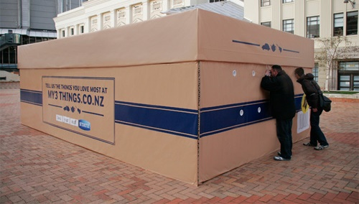

How Stakeholders See a Project

Slide 26
Business Change Management
Delivering the Change
The Project
Business as Usual
New Business as Usual
Embedding the Change

Slide 27
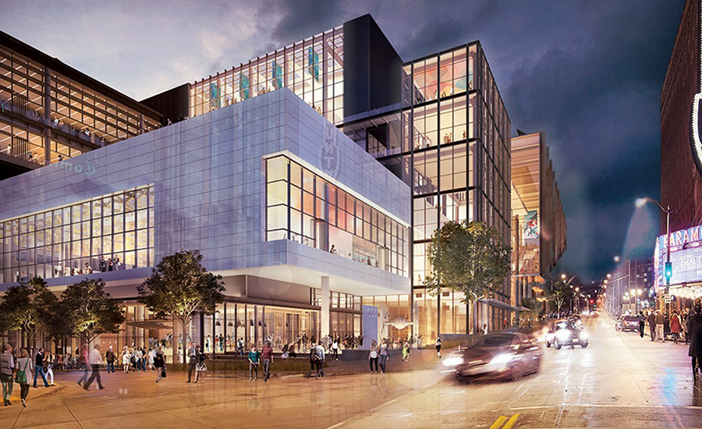
Delivering the Change…

Slide 28

Delivering the Change…
Vs. Embedding the Change

Slide 29
Results Are What’s Created When the Change Has Been Embedded
Outputs
Outcomes
Benefits

Slide 30
How Can Projects Help to Embed the Change?

Slide 31
Business Change Management Concerns
Process/Procedure Changes
Coordination with On-Going Operations
Representing User Issues/Requirements
Ensuring Initial/Recurring Training Participation
Planning to Sustain the Change
Measuring Outcomes & Benefits

Slide 32


Change is Always Disruptive
Project
Old Business as Usual
New Business as Usual

Slide 33
Projects will Always Encounter Resistance
Project
Organisational Inertia
Changes in Requirements
Fear of the Unknown
Deficiencies in New Solution
Competing Priorities
Legacy Capabilities
Lack of Information
Old Business as Usual
New Business as Usual

Slide 34
SCOPE MANAGEMENT THROUGH THE LIFECYCLE:
PROJECT Initiation

Slide 35
The Goal of Project Initiation:
Confirm that the desired organizational change is appropriate to be delivered as a project

Slide 36

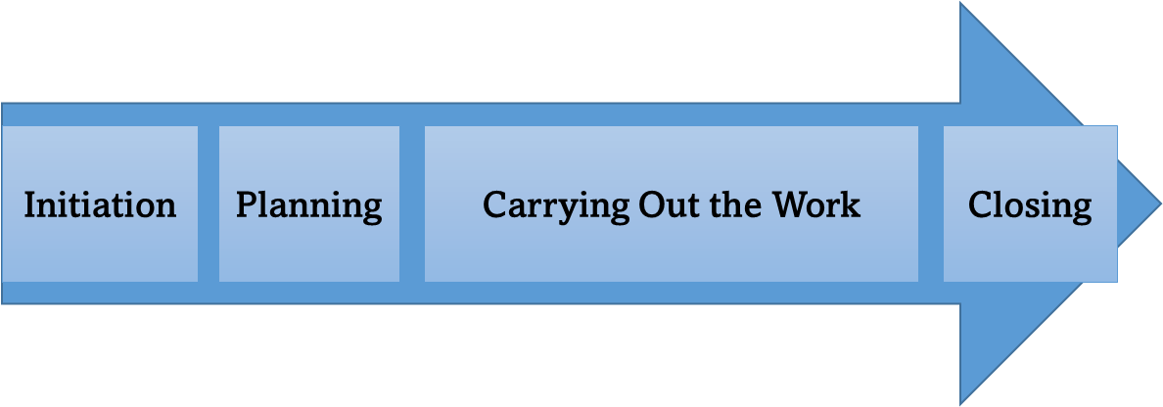
“Projects don’t GO wrong.
They START wrong.”

Slide 37
Exercise #1:
Imagine you’re the PM for the Finance 26 project.
  What are three questions you’d like the Project Sponsor to answer early in Project Initiation?

Slide 38
Initiation
Business Case
Change Drivers
Organizational Assets
Enterprise/Environmental Factors
Project Inputs: The Why
Output: Project Charter

Slide 39
Project Business Case
In theory:
  Developed by the project sponsor
  Estimates the costs, implementation issues, desired outcomes and expected benefits
  Provides the basis for Project Initiation and Project Charter
  Reviewed and updated throughout the project’s life cycle

Slide 40
Project Business Case
In practice:
  Developed by the project sponsor
  Estimates the costs, implementation issues, desired outcomes and expected benefits
  Provides the basis for Project Initiation and Project Charter
  Reviewed and updated throughout the project’s life cycle
All, Some, or None of These

Slide 41
Reverse Engineering the Project Business Case
In many cases, projects are initiated without a complete Business Case
This means the Business Case is assembled through work through Project Planning:
  Identifying the Business Needs
  Describing the “As Is” and “To Be” situations
  Identifying Project Stakeholders
  Defining the Project Scope
  Analyzing options and their costs and benefits

Slide 42
The Basic “Why” Model
Projects deliver outputs
The outputs enable outcomes
The outcomes realize benefits
The benefits achieve strategic objectives

Slide 43
A Benefits Model
Relocated Finance & HR Depts
Reduced Cost of Operation
Increased Return on Investment
Project
Delivers
Output
Outcome
Benefit
Enables
Realizes

Slide 44
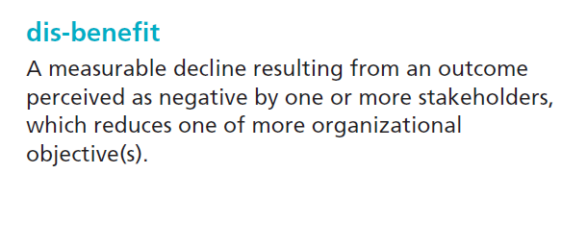
Disbenefits
Scope Management Secrets: Day Two

Slide 45
Exercise #2:
For the Finance 26 project, identify:
  Two expected Outcomes
  How/When they could be measured
  A Benefit (or Disbenefit) that could be achieved from each Outcome

Slide 46
SCOPE MANAGEMENT THROUGH THE LIFECYCLE:
SCOPE PLANNING, Part 1:
Organizing Scope

Slide 47
Organizing Scope:
Capturing what should be in the project’s scope
Confirming what won’t be in the project’s scope
Allocating scope to Work Packages or Products
Putting the leftovers in a Holding Space

Slide 48

Project as a Journey
How do we get there?
Where are we going?
What obstacles will we encounter along the way?
Do we have enough time, money, people and information to get there?
How will we know we’re making progress?
5 Key Questions

Slide 49
The Project Plan
Do we have enough time, money, people and information to get there?
Where are we going?
Requirement
Implementation Approach
Cost and Schedule Estimate
Risk Assessment
Project Management Approach
How do we get there?
What obstacles will we encounter along the way?
How will we know we’re making progress?

Slide 50
Project Scope Elements
Work Breakdown Structure and Work Packages
Products and Product Breakdown Structure
Holding Spaces
  Assumptions
  Issues
Scope Management Secrets: Day Two

Slide 51
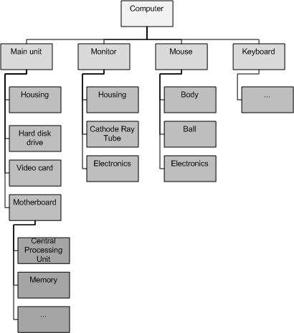
Product Breakdown Structure
Where are we going?

Slide 52
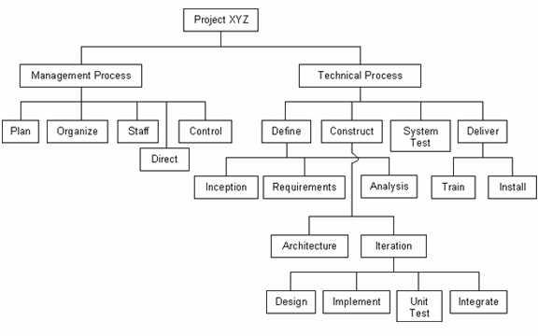
Work Breakdown Structure
How do we get there?
Scope Management Secrets: Day Two

Slide 53
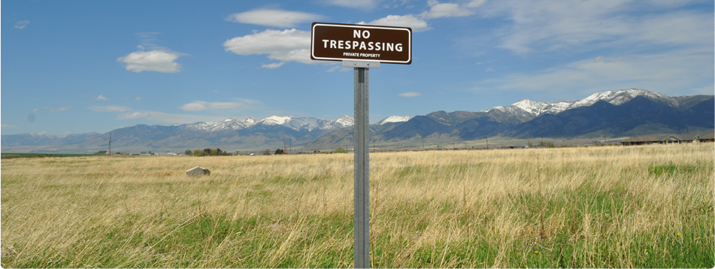
Boundaries
Where does the project stop?
If You Know What’s In Scope
You Should Be Able to Tell What’s
Out of Scope

Slide 54
Holding Space
Where does the project stop?
Holding Space
List of needs that may
or
may not be requirements
If You Know What’s In Scope
You Should Be Able to Tell What’s
Out of Scope

Slide 55
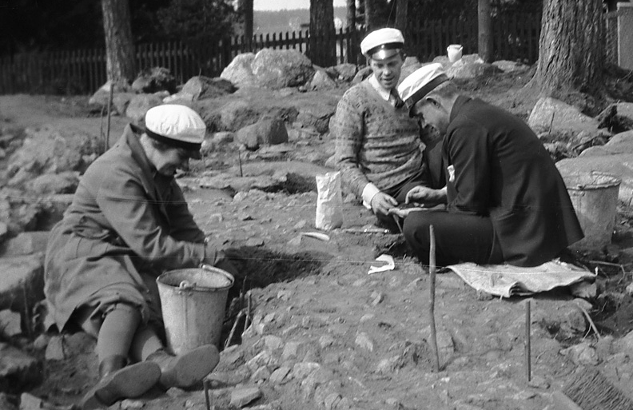
Project Archaeology

Slide 56
Project Archaeology
Organizational strategy/planning documents
Policies and procedures
    How projects are managed
    How the affected/supporting business units operate
Templates
Lessons identified/learned
Subject Matter Experts
Tools/Applications/Databases/Portals

Slide 57

Where do requirements come from?

Slide 58
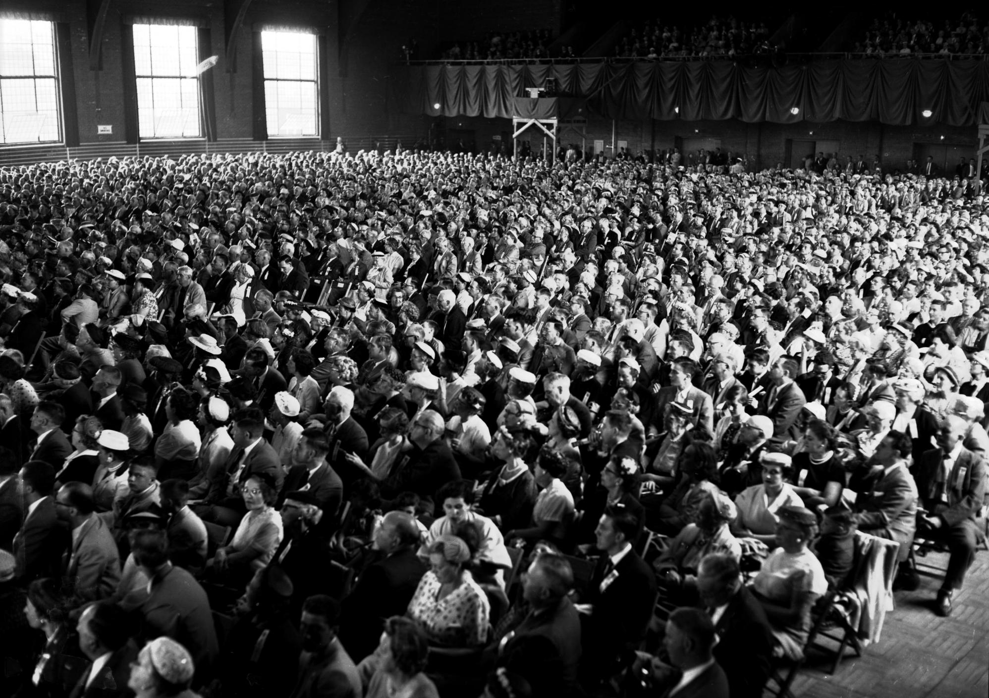
Stakeholders

Slide 59

The Onion Model
Executive Leadership
Business Process Owners
Support Users
End Users

Slide 60
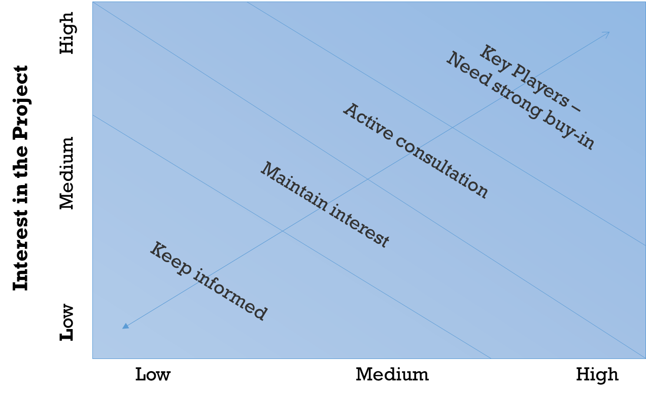
Interest/
Influence
Matrix

Slide 61
Interest/
Influence
Matrix
Start by identifying the organisations and people in this space

Slide 62
Exercise #3:
Describe the Head of the Finance Department of AGMC:
  Internal/External?
  Influence?
  Interests?
  Authority?
  Rights?
  Ownership?
  Knowledge?
  Contribution?
  Means to Communicate/Engage?

Slide 63

Analyzing Scope

Slide 64

The Challenge of Requirements Elicitation
The Stakeholder’s Perspective
The Project’s
Perspective
It is hard to find someone with 20/20 vision in both

Slide 65
Business Systems Analyst
Business Analyst
Business Systems Analyst
Systems Analyst
Business processes
System capabilities
Automated business processes
Business processes
Information systems

Slide 66
Business Systems Analyst & Requirements
Business process requirements
System requirements
Business Analyst
Business Systems Analyst
Systems Analyst
Business processes
System capabilities
Automated business processes
Business processes
Information systems

Slide 67
Requirements Elicitation/Analysis
AGMC/eGadget
Business
Processes &
Stakeholders
Project
Scope
Baseline
Will Finance 26 Need a Business Systems Analyst?

Slide 68

The New Software
Functionality
  Business Processes
  Skill Levels
Non-Functional Requirements
  Security
  Support
  Data migration
  Interfaces
  IT Support

Slide 69
The New Software
Costs
  Investment
  Licensing
  Support
Delivery:
  Cloud vs. On-Premise

Slide 70

Market Survey
Available Products
  Functionality
  Pricing
Procurement/Implementation options
Experiences of Other Users

Slide 71
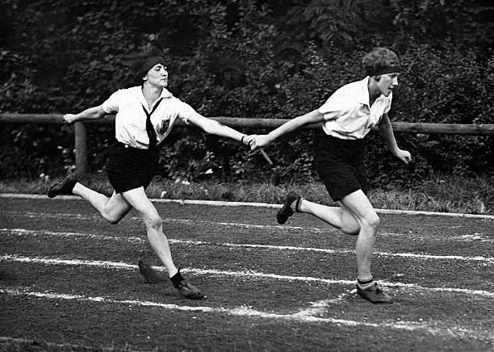
Transition to Operations: Planning

Slide 72
There are two kinds of projects ….
Something
Nothing

Slide 73
There are two kinds of projects ….
Something
A Running Operation

Slide 74


There are two kinds of teams ….
Something
A Running Operation

Slide 75

Project
Delivery

Slide 76

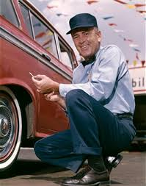
After Delivery

Slide 77
Operations is what turns
Project Outputs
into
Organizational Benefits

Slide 78

Operations turns
Project Outputs
into
Organizational Benefits
Positive
^

Slide 79
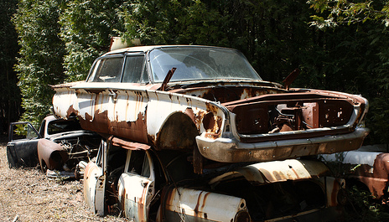
Operations turns
Project Outputs
into
Organizational DIS-Benefits
Or

Slide 80
Service Management/
Operations Management
Frameworks
Scope Management Secrets: Day Two

Slide 81
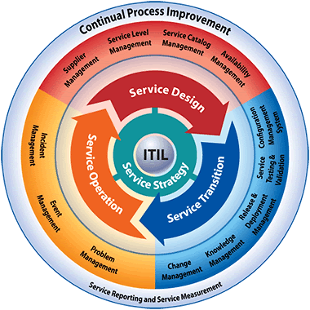
ITIL
Scope Management Secrets: Day Two

Slide 82
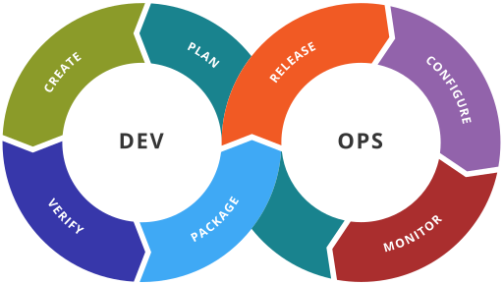
Scope Management Secrets: Day Two

Slide 83
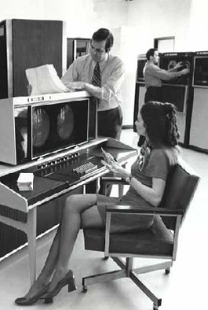
What It All Boils Down To:
Keeping Things Running
Fixing What Breaks
Improving Performance
Introducing Changes
Scope Management Secrets: Day Two

Slide 84
What It All Boils Down To:
Keeping Things Running
Fixing What Breaks
Improving Performance
Introducing Changes
Scope Management Secrets: Day Two

Slide 85

 People
 Processes
Technology
✓
Change Checklist
✓
✓
Scope Management Secrets: Day Two

Slide 86
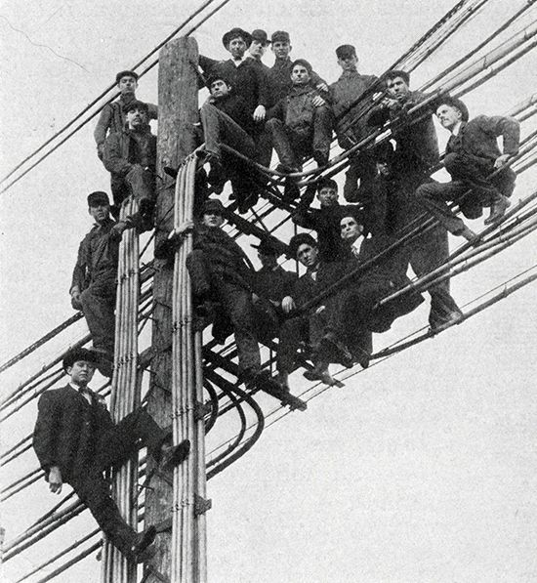
People
Roles
Skills
Organization
Turnover
Scope Management Secrets: Day Two

Slide 87
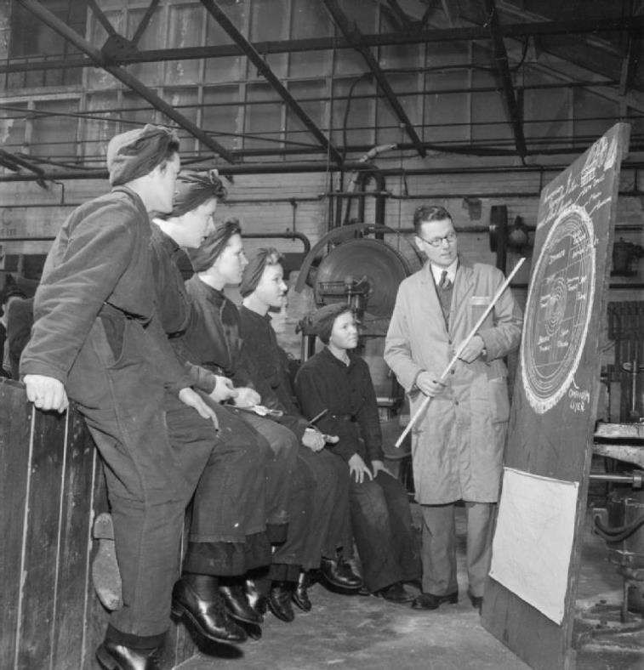
Training
Initial
Recurring

Slide 88


Synergies
Complexity
of
Functionalities
Job
Description
Required Skills
User
Design
System
Welcome
to Class!
Required Skills
Minus
Job Prerequisites
Training

Slide 89

Processes
Adaptation
Integration
Quality Control
Supply Chain
Scope Management Secrets: Day Two

Slide 90

Documentation

Slide 91
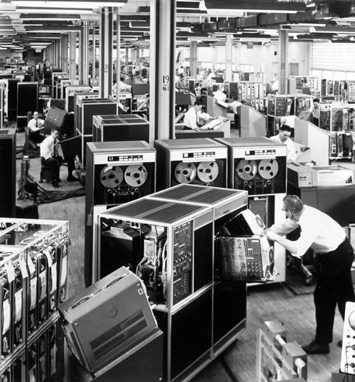
Technology
Installed Base
New Systems
Support Needs
  Testing
  Troubleshooting
  Repair
  Replacement
Scope Management Secrets: Day Two

Slide 92

Transition
  Who has the authority to decide:
  Go Live
  Back Out
  Accept Operational capability
Scope Management Secrets: Day Two

Slide 93
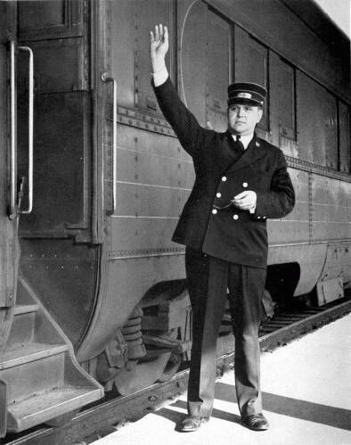
Schedule Impacts
Preparation
Installation/Test
Activation
Transition
Post-Activation Support
Disposal
Scope Management Secrets: Day Two

Slide 94
Scope
 People
 Process
Technology
Will these influence the Product Breakdown Structure?
The Work Breakdown Structure?
Assumptions and Risks?
✓
✓
✓
Scope Management Secrets: Day Two

Slide 95
Work Aspects: Change Approach
Green Field?
    Little or no existing infrastructure, least impact on current operations
Upgrade/Improvement?
    Backwards compatibility, synchronization with existing operations, before/after comparisons
Transformational?
    Transition from “As Is” to “To Be,” slack in transforming workforce, before/after comparisons

Slide 96
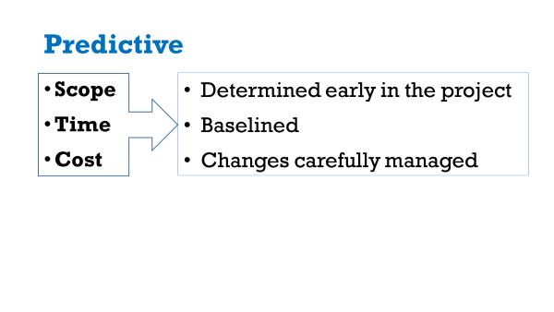
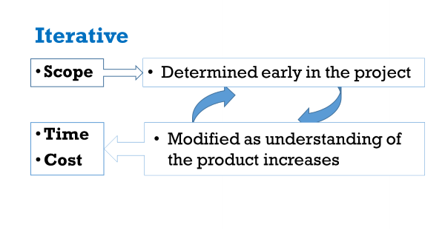
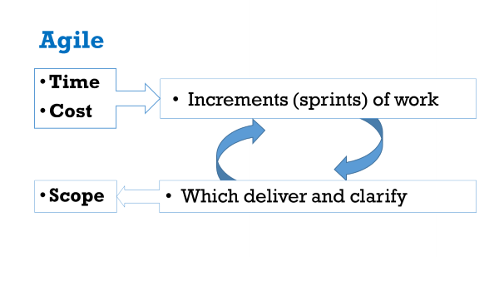
What is the Change Model?

Slide 97
Project team
Aspects to consider:
  Co-located? Dispersed? Virtual?
  Do they share a common language? Culture? Time Zone?
  What is the level of commitment of team members?
  What are their Priorities? Constraints?
  What is their level of authority?
  What is their level of expertise/experience?

Slide 98
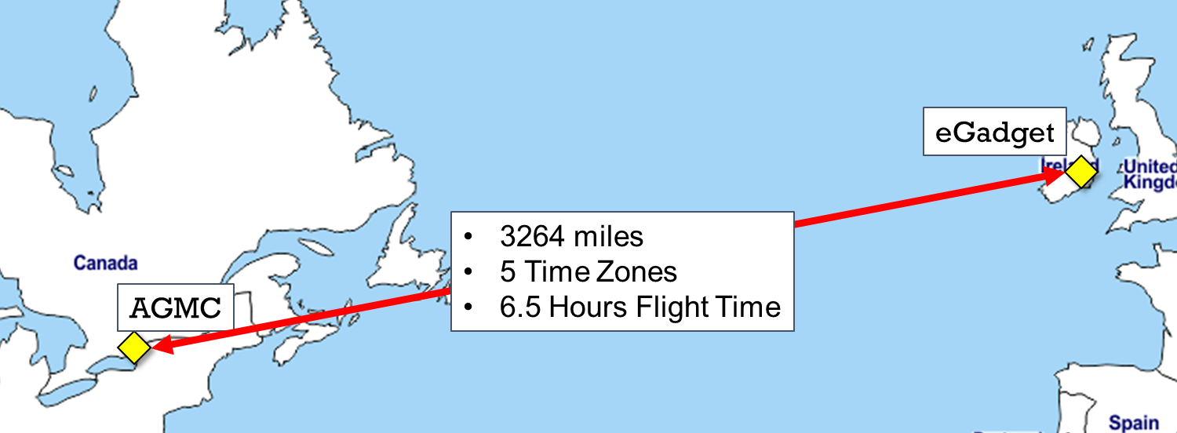
Geography

Slide 99
Project Support Issues - IT
Information & Knowledge Management
    Repository
    Logs
    Reporting
Requirements Tools
    Business Analysis
    Requirements Database
Communications
    Email
    VTC
    Chat/Collaboration

Slide 100
Q:
What IT tools do you use on your projects?

Slide 101
Project Support Issues – Admin/HR
Paying for the Project Management Team
Workspace
Travel
Other Commitments

Slide 102
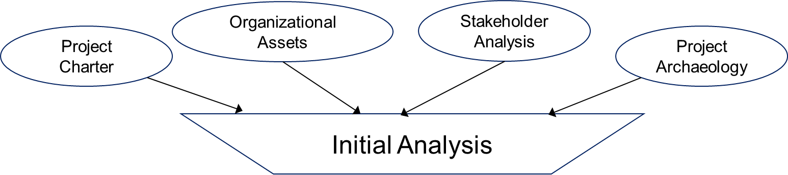

Requirements Analysis
WBS
Elicitation& Collection
Allocate
PBS
System
Requirements Specification
Allocate
Analysis
Hold
Holding
Space
Assumptions Log
Rework
Reject
Issue Log

Slide 103
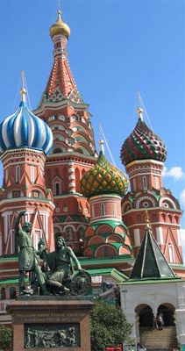
MoSCoW Analysis: Sorting Through Requirements
Must Have
Should Have
Could Have
Won’t Have

Slide 104
MoSCoW Analysis: Sorting Through Requirements
Must Have
Should Have
Could Have
Won’t Have
Definitely In
Scope
Definitely Out

Slide 105
Governance
Who/What does the Project Manager report to?
  Internal Project Management
  Project Board
  Project Sponsor
  Program Management Office
  Corporate Board or Committee
  Public Board or Committee
Are there any back-channels? Do they matter?

Slide 106
Decision Making
Who can approve changes to:
  Project Scope Baseline?
  Contracts and Agreements?
  Project Budget?
  Project Schedule?
And how fast do these processes work?

Slide 107
Assumptions
An assumption is an assertion about the future upon which a plan rests
An assumption is important if its negation would invalidate some aspect(s) of the plan
The more uncertain the assumption,
the greater the resulting risk
Scope Management Secrets: Day Two

Slide 108
Types of Assumptions
Resources – People, materials, or facilities needed
Cost – Assumptions behind estimates
Finances – Availability of funding
Scope – Clarity/Uncertainty about What (PBS)/How (WBS)
Schedule – Assumptions behind estimates of duration, sequencing
Approach – Fitness of implementation approach
Technology – Products, Vendors, Infrastructure
Market – Availability, competition, dynamics
Politics – Organizational, external, interest groups
Scope Management Secrets: Day Two

Slide 109
Exercise #4:
Based on your understanding of Finance 26, please prepare the top-level:
  Work Breakdown Structure
  Product Breakdown Structure

Slide 110
Scope Management is NOT a Waterfall Process
Planning
Plan Scope Management
Collect Requirements
Define Scope
Create WBS
Validate Scope
Control Scope
2
4
1
5
3
6
Monitoring & Controlling

Slide 111
SCOPE MANAGEMENT THROUGH THE LIFECYCLE:
SCOPE PLANNING, Part 2:
ASSESSING RISKS, COSTS, CONTROLS

Slide 112
Assessing Scope:
Estimating the costs of what’s in scope
Assessing the risks facing project delivery
Identifying ways to mitigate the risks
Proposing how to monitor and control delivery

Slide 113
The Project Plan
Do we have enough time, money, people and information to get there?
Where are we going?
Requirement
Implementation Approach
Cost and Schedule Estimate
Risk Assessment
Project Management Approach
How do we get there?
What obstacles will we encounter along the way?
How will we know we’re making progress?

Slide 114
WBS Impacts on Cost
Build Radio Station
Purchase Land
Manage Project
Construct Building
Install Equipment
Transition to Operations
Procurement
Costs
Activity &
Procurement
Costs
Activity &
Procurement
Costs
Activity
Costs

Slide 115
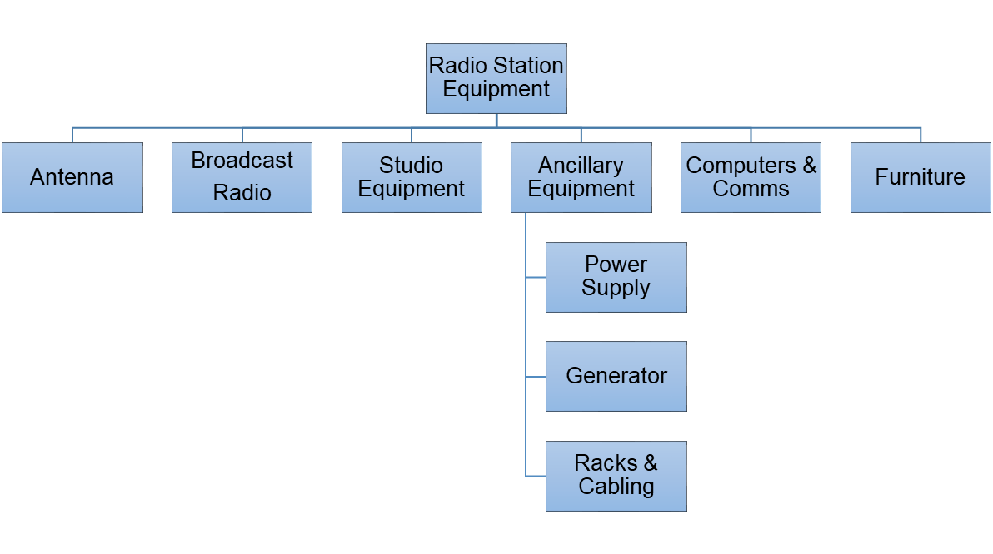
PBS Impacts on Costs
Procurement Costs
Procurement Costs
Procurement Costs
Procurement Costs
Procurement Costs
Procurement Costs

Slide 116
Assumptions Create Risks
Assumption | Risk
Project will be able to find a suitable new space | Finance will not be able to vacate before its lease expires
 | Project will not realize the expected Return on Investment
Employees will agree to work at the new location, whether downtown or in suburbs | Productivity of HR and Finance will be reduced due to shortages and turnover
 | Project will not realize the expected Return on Investment
Scope Management Secrets: Day Two

Slide 117
Risks Require Responses
Risk | Mitigation Measure
Finance will not be able to vacate before its lease expires | Explore lease extension
 | Explore alternative of refit/expansion of existing facility
 | Explore alternative of remote working
Productivity of HR and Finance will be reduced due to shortages and turnover | Survey employees to determine critical location factors and priorities
Scope Management Secrets: Day Two

Slide 118
Organizational and Product Maturity
Have we done this type of work before?
Have we dealt with this type of product before?
If not … Is there anyone we can copy learn from?

Slide 119
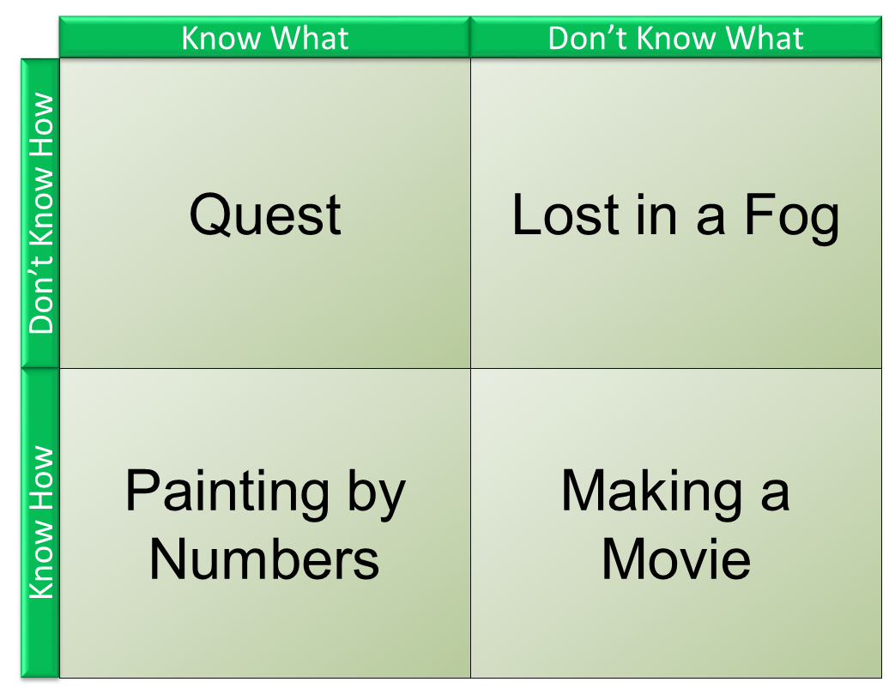
Know What/Know How Matrix
?
Finance 26

Slide 120
Requirements Quality Model
Requirements Quality
Level of User Knowledge
Organizational
Uniqueness
Use
User Concentration
Senior Leadership Engagement
Requirements Trade Space
Skill Level
Doctrine/Procedure Level
Existing Use
Frequency
Consistency
New Mission/Task
Centralized
Distributed
High
Low
Flexible
Inflexible
High
Low

Slide 121
Organizational Culture
AGMC
eGadget
Family-owned, family-run
Founded in 1905
Plants in Canada and USA
Average age in the Finance department: 43
CEO-driven, virtual C-suite
Founded in 1995
Outsourced manufacturing
Average age in the Finance department: 29
Scope Management Secrets: Day Two

Slide 122
Change Appetite
Open to Experimentation
Leaning Forward
High
What Can the Project
Expect To Encounter?
Resistance
&
Inertia
“The Spirit is Willing but the Flesh is Weak”
Readiness
Low
Low
High
Urgency

Slide 123

Cognitive Biases
Groupthink
Overconfidence
Selective Perception
Sunk Cost
Illusion of Control
Available Data

Slide 124
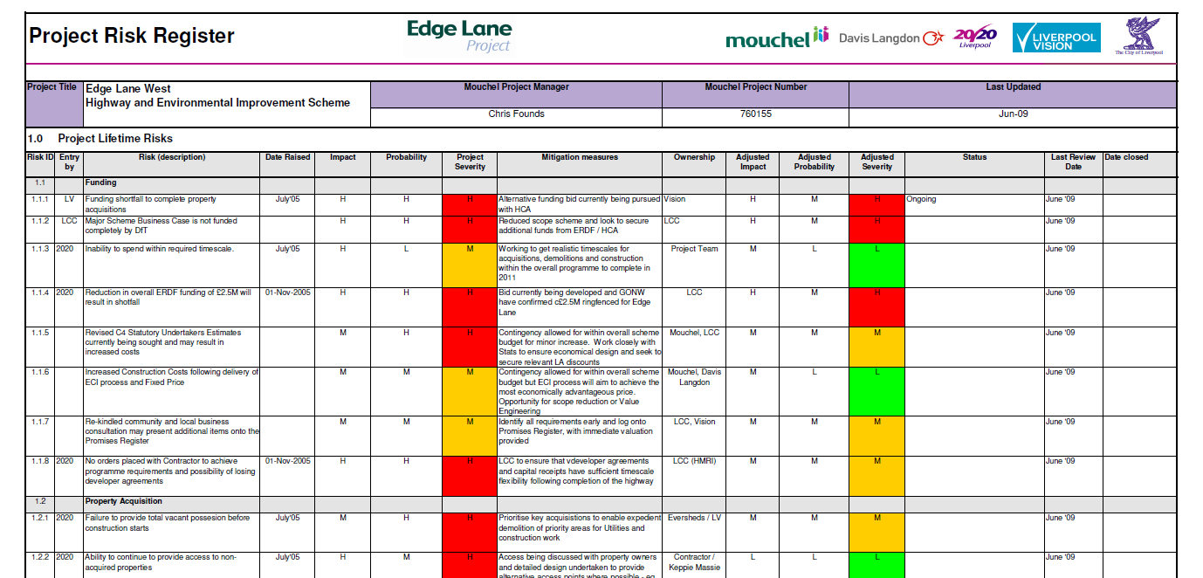
Risk Register
What obstacles will we encounter along the way?

Slide 125
Risk Register
Risk Statement: What could go wrong?
Impact: If this happens, then how big of a problem would it cause?
Probability: How likely is it to happen?
Time: When could it happen?
Cost: What could be the financial impact?
Response: What could/should be done to:
  Avoid it happening
  Mitigate its impact if it does
Scope Management Secrets: Day Two

Slide 126
Risk Responses
Estimates with confidence levels/margins of error
Contingency budget
Change budget
Tolerances
Costed Risks
Adaptive Life Cycle
Rolling Backlog
Scope Holding Space
Most Important of All:
Constant
Communication!
Scope Management Secrets: Day Two

Slide 127
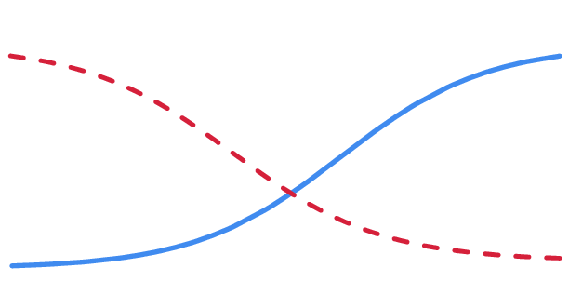
Mitigating Risk & Cost of Change
Trade Space
Sponsor’s Reserve
Project
Baselined
PM’s Reserve
Risk
Cost of Changes
Approved Change Budget
Will Finance 26 need Change & Reserve budgets?
Approved &
Allocated Budget
Time

Slide 128

Congratulations!
You’ve got a Project Plan.
Now get back to work.
Scope Management Secrets: Day Two

Slide 129
SCOPE MANAGEMENT THROUGH THE LIFECYCLE:
PROJECT EXECUTION

Slide 130
Project Execution
Initiating Work
Updating Baselines
Managing Backlog and/or Scope Change
Managing Acceptance
Scope Management Secrets: Day Two

Slide 131
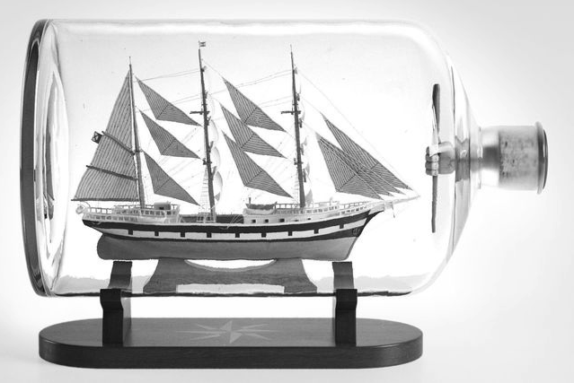
Project Execution
Limits of the Project Baseline:
  Time
  Cost
  Scope

Slide 132
Two Aspects of Project Execution
What’s Going On Outside the Project
What’s Going On Outside the Project
What’s Going On Inside the Project
Scope
Change Management
Issues
Time
Risks
Requirements
Cost
Stakeholders
Contracts

Slide 133
System for Value Delivery
External environment
Internal environment
System for Value Delivery
Portfolio
Portfolio
Program
Program
Program
Program
Projects
Projects
Projects
Projects
Projects
Projects
Operations

Slide 134
System for Value Delivery
External environment
CHANGING
Internal environment
CHANGING
System for Value Delivery
CHANGING
Portfolio
Portfolio
Program
Program
Program
Program
Projects
Projects
Projects
Projects
Projects
Projects
Operations
CHANGING

Slide 135
Monitoring and Control
Tools:
  Reporting (against WBS/PBS)
  In-work checkpoints
  Milestone reviews
  Product Backlog
  Change requests
  Deficiency reports
  Lessons Identified/Lessons Learned

Slide 136
Monitoring and Controlling
The Aim is to Identify and Fix Problems as Early as Possible
Quality = Honesty
Proactive vs. Active vs. Reactive

Slide 137
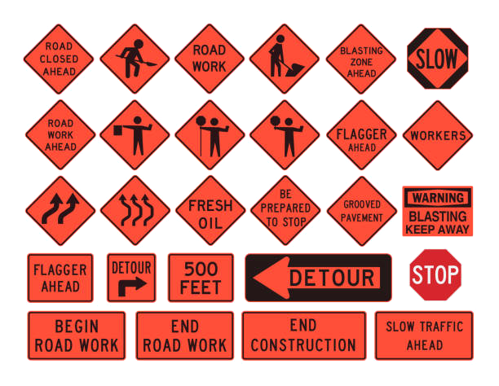
Every project that lasts more than 6 months WILL have to deal with changes

Slide 138
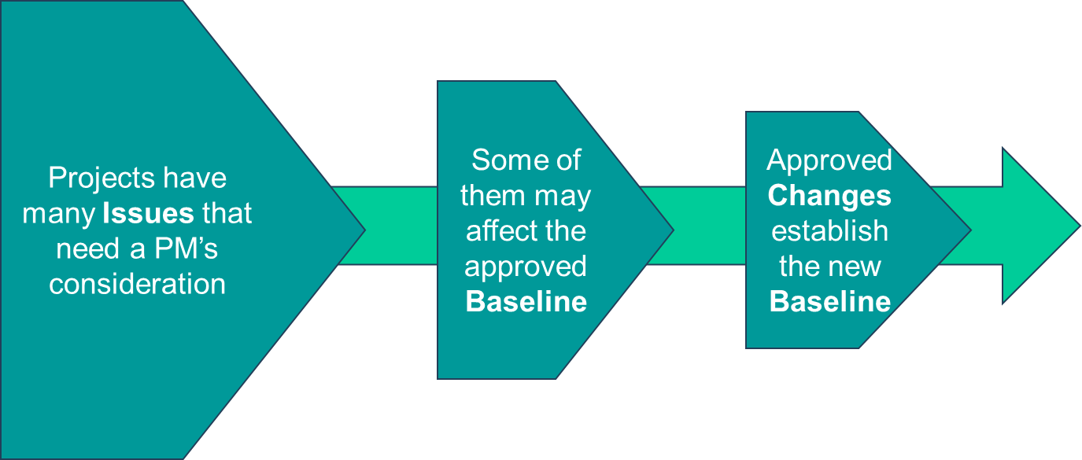
Issues vs. Changes

Slide 139
Issues vs. Changes
Issue
  An event relevant to the project that requires PM attention
Change
  A modification to any of the baseline elements of the project
    Budget
    Schedule
    Scope

Slide 140
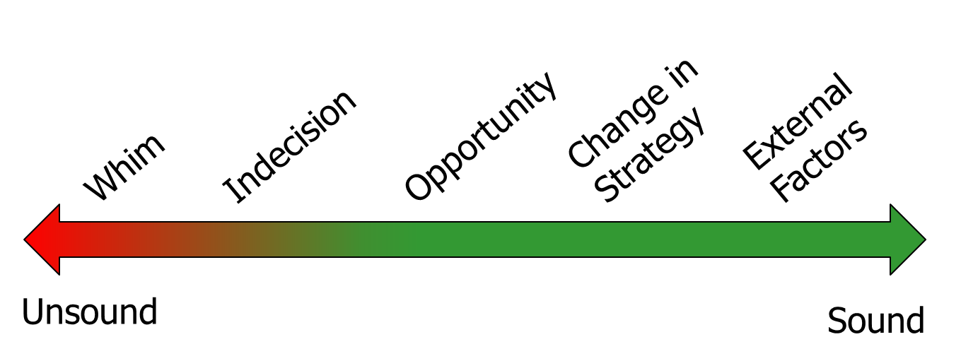
What is the Motivation for the Change?

Slide 141
Change Control
Identify
Assess
Approve/Disapprove
Reflect via Baseline Changes

Slide 142



Change control
Change
Baseline Schedule
Time
Baseline Budget
Evaluate Changes in Terms of Changes to the Baselines
Scope Baseline
Scope
Cost
If this increases
Then so must one or both of these

Slide 143
Requirements Analysis
New Require-ment
WBS
Elicitation& Collection
Allocate
PBS
System
Requirements Specification
Allocate
Analysis
Hold
Holding
Space
Assumptions Log
Rework
Reject
Issue Log

Slide 144
Requirements Analysis
WBS
Elicitation& Collection
Allocate
PBS
System
Requirements Specification
Allocate
Analysis
Hold
Holding
Space
Assumptions Log
Rework
Reject
Issue Log
New Require-ment
Ignore?
Transfer to PMO?

Slide 145
Requirements Analysis
WBS
Change Request
Elicitation& Collection
New Require-ment
Allocate
PBS
System
Requirements Specification
Allocate
Analysis
Hold
Holding
Space
Assumptions Log
Rework
Reject
Issue Log

Slide 146
Integrated Change Assessment
How does the Change affect:
  Scope Baseline?
  Schedule?
  Cost?
  Quality?
  Resources?
  Communications?
  Risk?
  Procurement?
  Stakeholders?

Slide 147
Change Choices
Change the scope of the existing project
Cancel the project
Transfer the change to another
Transfer the change to new project
Do Nothing

Slide 148
WBS/PBS Impacts:
Change an existing element:
  Quality (performance, specifications)
  Quantity
  Timing
  Sequencing
  Cost
Add a new element
Delete an existing element
Any combination of the above

Slide 149
Requirements Analysis
WBS
Elicitation& Collection
Allocate
PBS
System
Requirements Specification
Allocate
Analysis
Hold
Holding
Space
New Require-ment
Assumptions Log
Rework
Reject
Log for Review
Issue Log

Slide 150
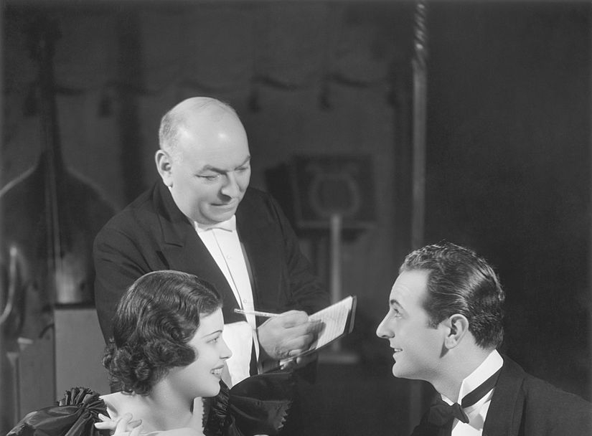
Exercise #6:
The Attack of the Hidden Assumptions!
Which would you like, sir?
Missing Data? Incorrect Data? Duplicate Data?
Uh-Oh.

Slide 151
Transition to Operations: Execution

Slide 152
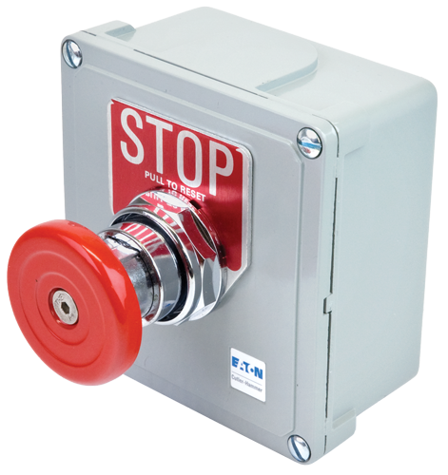
Transition
  It’s Rarely as Simple as Hitting the Stop Button

Slide 153

It’s More Like Trying to Land on an Aircraft Carrier …

Slide 154
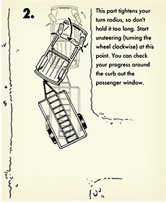
Transition
  Prepare to Back Out if Things Go Wrong

Slide 155

Transition
  It’s Always
  a Good Idea to Reserve Some Time and Resources for
  Post-Activation Fixes

Slide 156
Acceptance
Work acceptance
Product acceptance
Contractual acceptance
Considerations:
  Criteria
  Approach
  Dealing with Deficiencies

Slide 157
Assessment
Beginning to measure benefits realization using assessment deliverables
Lessons learned reviews can be tied to milestones/gate decisions

Slide 158
SCOPE MANAGEMENT THROUGH THE LIFECYCLE:
PROJECT CLOSURE

Slide 159

Closing

Slide 160
Acceptance
Work ends … Products get used/owned
Who takes ownership?
  And what happens afterward?

Slide 161
Transition
What happens to the scope management artefacts?
  Archived
  Handed over
  Maintained by PMO
  ….?

Slide 162
Audit/Lessons Learned
Financial: Closing the Project Budget
Asset Accounting
Management: Performance Audit
Outcome/Benefits Tracking
Project: Lessons Learned Review

Slide 163
The Larger Life Cycle
What Happened in the Past
What Led to Project Initiation
What is Going On During the Project
What will Happen After the Project

Slide 164
The Larger Life Cycle
What Happened in the Past
What Led to Project Initiation
What is Going On During the Project
What will Happen After the Project
Outcome
Output
Benefit
Output
Outcome
Benefit
Output
Outcome

Slide 165

The success of a project is usually measured after it’s over.

Slide 166
Exercise #7:
Finance 26 is finished:
  Four months late
  3 million Euro over budget
How can we tell if we have achieved the outcomes and realized the benefits?

Slide 167
Yesterday’s Feedback
The Role of BSAs (Business Systems Analysts)
How to Build a PMO
Working with Operations/Service Management
Resources/Books to Read

Slide 168
Managing Change Across Multiple Projects or,
Why You Need Program Management

Slide 169
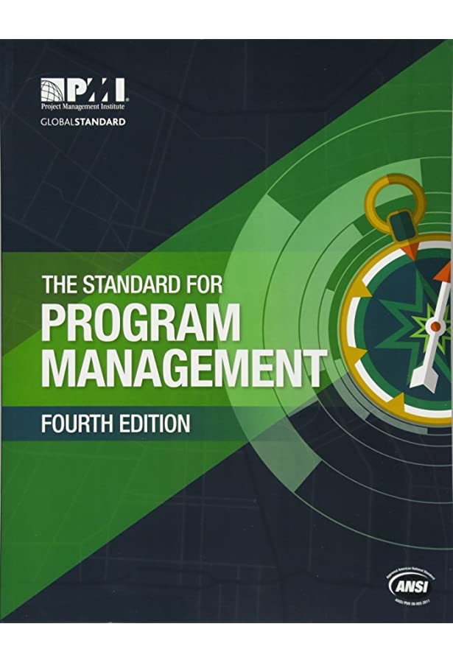
What is a Program?
A program is defined as related projects, subsidiary programs, and program activities managed in a coordinated manner to obtain benefits not available from managing them individually.

Slide 170
What is a Program?
A program is defined as related projects, subsidiary programs, and program activities
managed in a coordinated manner to obtain benefits not available from managing them individually.

Slide 171


What is a Program?
Projects deliver the pieces
Program management makes sure they fit

Slide 172
What is the Value Added?
Projects deliver the pieces
Program management makes sure they fit

Slide 173

IT Projects In a Nutshell
Each IT Project delivers a piece of a jigsaw puzzle
But the other pieces are changing at the same time!
Notes:
In a nutshell, the unique challenge of IT projects is to deliver an effective set of outputs when many of the other elements of the organization and its IT infrastructure are undergoing numerous changes themselves.

Slide 174
IT Projects have lots of interfaces
Customized Business Applications
Core Enterprise Service Applications
Project ABC
Service Management
Operating Systems
Processing and Storage Systems
Information Security
Enterprise-wide COTS Applications
Network Services
Notes:
Another unique aspect of IT projects is the fact that they are typically rich in interfaces.

Slide 175
Interfaces = Interdependencies
Customized Business Applications
Core Enterprise Service Applications
Project ABC
Service Management
Operating Systems
Processing and Storage Systems
Information Security
Enterprise-wide COTS Applications
Network Services
Notes:
The number and complexity of IT project interfaces, when seen from the project manager’s perspective, are prime sources of interdependencies.

Slide 176

Interdependency: the Theory
A Project Manager should establish
a bi-lateral control mechanism
at every point where the project:
  Depends on an input from another project
  Provides an output to another project
Notes:
In theory, a good project manager will identify where there are interfaces with other projects and activities and establish appropriate control mechanisms to keep track of them.

Slide 177

Interdependency: The Reality
Project Managers HATE Interdependencies
Notes:
Unfortunately, in reality, project manager hate interdependencies and try to minimize them wherever possible.

Slide 178
Why?
Interdependencies are sources of:
  Schedule slips
  Cost increases
  Scope creep
  Uncontrolled risks
  Technical complications
Notes:
Why? Because of all the undesirable effects that can be introduced through these interdependencies.

Slide 179
But—How Many IT Projects Deliver Value If …
Customized Business Applications
Project ABC
… they deliver products that are not interoperable with other custom applications?
Notes:
Here we come to another problem with IT projects.
Here are a few examples of the dangers of not being prepared to manage a complex set of interfaces and interdependencies.

Slide 180
But—How Many IT Projects Deliver Value If …
Core Enterprise Service Applications
Project ABC
… they deliver products that are not integrated with Core Enterprise Applications?

Slide 181
But—How Many IT Projects Deliver Value If …
Project ABC
The Cloud
Operating Systems
Processing and Storage Systems
… they require non-standard operating systems,
hardware or connectivity?
Network Services

Slide 182
But—How Many IT Projects Deliver Value If …
… they don’t work with standard enterprise-wide COTS products?
Project ABC
Enterprise-wide COTS Applications

Slide 183
But—How Many IT Projects Deliver Value If …
Project ABC
Information Security
… they create security vulnerabilities?

Slide 184
But—How Many IT Projects Deliver Value If …
Project ABC
Service Management
… they require specialized management tools or skills the organization doesn’t have?

Slide 185
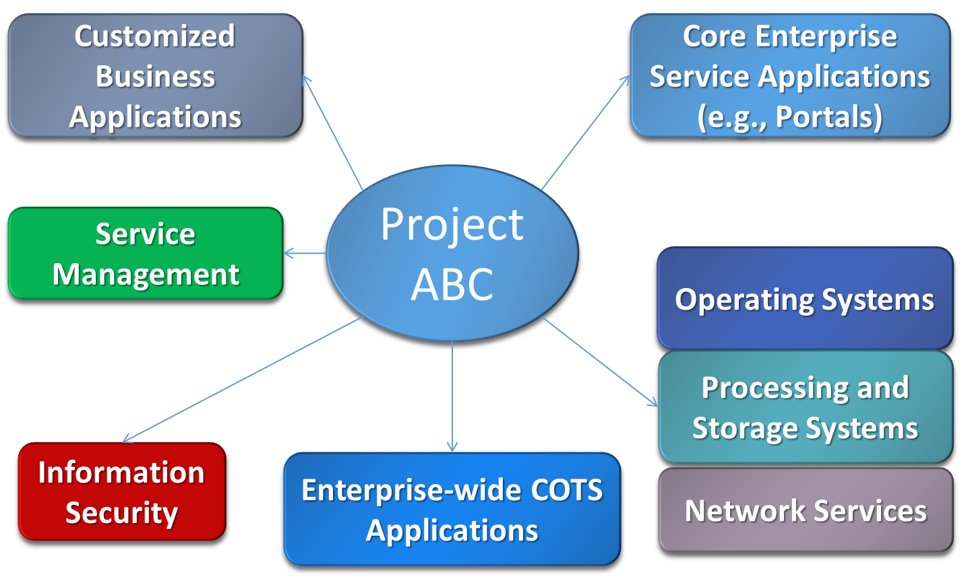
The Things that Create Interdependencies …
COST
RISK
DELAY
The Cloud
DELAY
COST
RISK

Slide 186
The Things that Create Interdependencies
Savings
Efficiencies
Efficiencies
The Cloud
Better
Service
Better
Security
Reuse
… Are Often the Things that Add Value
Notes:
While a project manager may dislike interfaces as sources of interdependencies and try to minimize them, these are often essential to the ultimate benefits to be achieved from the project.

Slide 187
Peer-to-Peer Change Management
Without centralized change control, inter-project change quickly becomes unmanageable
Project
Project
Issue
Change
Change
Project
Change
Project
Issue
Change
Issue
Change
Issue
Change
Project
Project
Change
Notes:
As noted earlier, when dealing with multiple projects, change management quickly becomes uncontrollable if it has to be addressed solely at the project level.

Slide 188
Program-Level Change Management
Program
Business
Units
Program Manager
O&M
Project
Mandate
Issue
Assessment
Change
Direction
Support
Change
Industry
Program
Change Management
Technology
Change
Interoperability
Change
Project
Creation
Partners
Project
Issue
Baseline
Change
Interface
Change
Project A
Project B
New
Project
Other
Programs
Notes:
Program-level change management was at the heart of the PMIC framework. We established a program change management function that took on the main responsibility for monitoring external and internal sources of change, of assessing those changes, and of managing how they were dealt with at the project level.
This took a major burden of monitoring and change management off the individual PMs.

Slide 189
Key Elements of Program Management
Standardization
Integration
Orchestration

Slide 190
Key Elements of Program Management
Standardization
Integration
Orchestration
Project Support Office

Slide 191
Project Support Office
Standard Project Management Artifacts
  PMPs, Schedules, Budgets, Risks, Reports
Standard Project Procedures
  Initiation, Planning, Reporting, Reviews, Acceptance
Centralized Project Reporting
Master Schedule
Requirements Management System

Slide 192
Key Elements of Program Management
Standardization
Integration
Orchestration
Program Management Office

Slide 193
Program Management Office
Program Architecture
  Management (how projects relate)
  Technical (how projects integrate)
Program-level Quality Control
Program-driven planning

Slide 194
Key Elements of Program Management
Standardization
Integration
Orchestration
Program Management Planning or Portfolio Management

Slide 195
Resources
pmi.org

Slide 196
Resources
projectmanagement.com

Slide 197
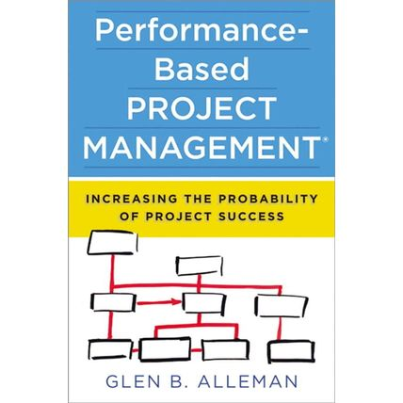

Books – Project Management/Business Change

Slide 198
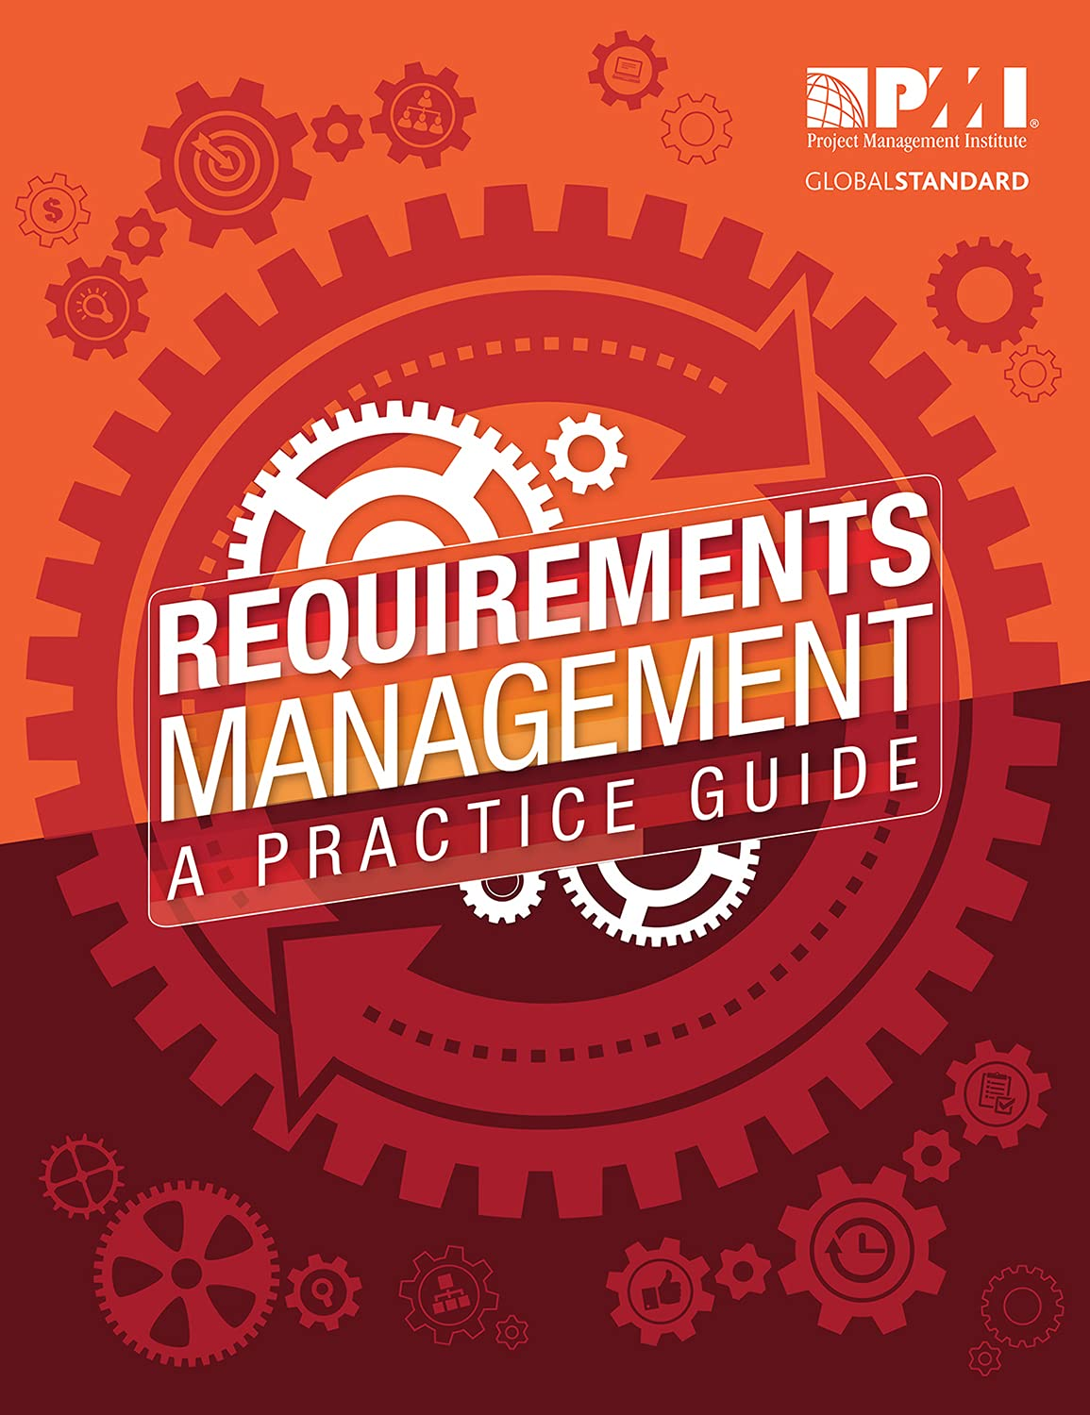

Books - Requirements

Slide 199

Questions?
Scope Management Secrets: Day Two

Slide 200


