Slide 1

SCOPE MANAGEMENT SECRETS
The Heart of Project Management
DAY ONE
Brad Bigelow, PMP

Slide 2

Disclaimer
The views and opinions expressed in the following PowerPoint slides are those of the individual presenter.
These PowerPoint slides are protected under the copyright laws of the United States of America and other countries. Used by permission. All rights reserved. Project Management Institute and PMI are registered trademarks. All other trademarks are the property of their respective owners.
The PowerPoint slides are for registered attendees of the PMI® SeminarsWorld®.
Scope Management Secrets: Day One
2

Slide 3
Learning Objectives
Accurately assess the scope of a project and organize it into well-defined and easily controlled elements
Effectively prepare Project Charters and Project Management Plans primed to ensure visibility, achieve expectations, and deliver results
Anticipate likely sources of scope change and formulate effective responses through change management
Scope Management Secrets: Day One

Slide 4
Course Overview
Day One: Understanding Scope Management
Day Two: Scope Management through
the Project Lifecycle
Scope Management Secrets: Day One

Slide 5
Day One: Understanding Scope
The Basics
The Not-So-Basics
Why Scope is Fuzzy
Why Scope is Risky
Exercises

Slide 6
SCOPE MANAGEMENT:
The Basics

Slide 7
Scope Management: At the Heart
Cost
Management
Schedule
Management
Risk
Management
Integration
Management
Scope
Management
Resource
Management
Quality
Management
Communi-cations
Management
Procurement
Management
Stakeholder
Management

Slide 8
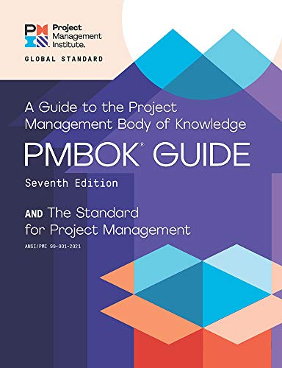
Project Management 101
“A project is a temporary endeavor undertaken to create
a unique product, service or result.”

Slide 9
Project Management 101
Finite Time
“A project is a temporary endeavor undertaken to create
a unique product, service or result.”

Slide 10
Project Management 101
Finite Time
“A project is a temporary endeavor undertaken to create
a unique product, service or result.”
Work

Slide 11
Project Management 101
Finite Time
“A project is a temporary endeavor undertaken to create
a unique product, service or result.”
Work
Output

Slide 12



“The Iron Triangle”
Time
Scope
Cost

Slide 13

Project
Managers
Scope
Time and Cost

Slide 14
Project
Executives
Scope
Time and Cost

Slide 15

Or, to Put Another Way …
Pick any two:
__ Better
__ Faster
__ Cheaper

Slide 16
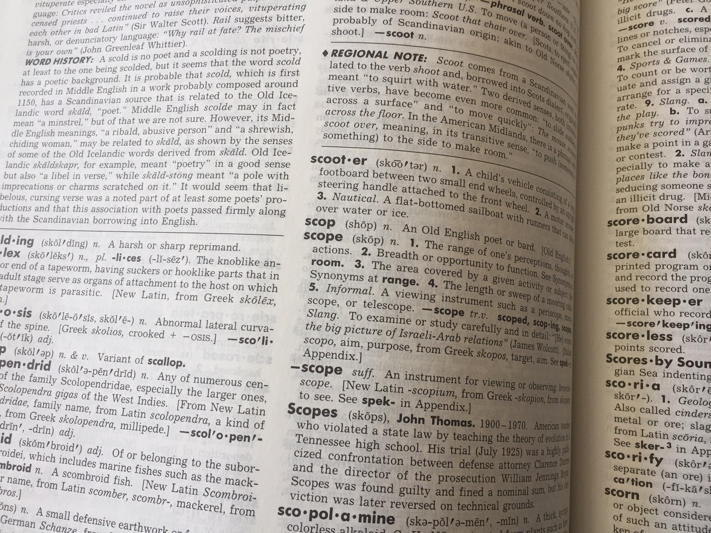
Definitions

Slide 17
PMBOK definition: Scope
“The sum of the:
  Products,
  Services, and
  Results
to be provided as a project.”

Slide 18
PMBOK definition: Product
“An artifact that is produced, is quantifiable, and can be either an end item in itself or a component item.
“Additional words for products are materials and goods.
“See also deliverable.”

Slide 19

PMBOK definition: Service

Slide 20
PMBOK definition: Result
“An output from performing project management processes and activities.
“Results include outcomes (e.g., integrated systems, revised process, restructured organization, tests, trained personnel, etc.) and documents (e.g., policies, plans, studies, procedures, specifications, reports, etc.).
“See also deliverable.”

Slide 21
PMBOK definition: Deliverable
“Any unique and verifiable product, result, or capability to perform a service that is required to be produced to complete a process, phase, or project.”

Slide 22
PMBOK definition: Scope Management
“The processes required to ensure that the project includes all the work required, and only the work required, to complete the project successfully.”

Slide 23
PMBOK definition: Scope Management
“The processes required to ensure that the project includes all the work required, and only the work required, to complete the project successfully.”

Slide 24
Key Concepts
“Scope can refer to:
Product scope
  The features and functions that characterize a product, service, or result
Project scope
  The work performed to deliver a product, service, or result.”

Slide 25
Key Concepts
“Scope can refer to:
Product scope
  The features and functions that characterize a product, service, or result
Project scope
  The work performed to deliver a product, service, or result.”
The What
The How

Slide 26
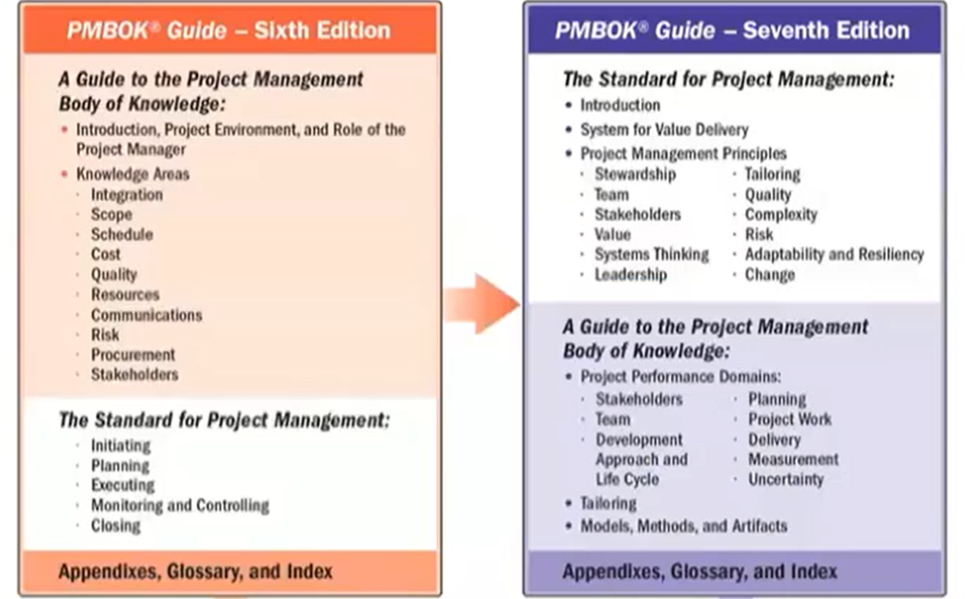
Changes: PMBOK 6th to PMBOK 7th

Slide 27
Changes: PMBOK 6th to PMBOK 7th

Slide 28
System for Value Delivery
External environment
Internal environment
System for Value Delivery
Portfolio
Portfolio
Program
Program
Program
Program
Projects
Projects
Projects
Projects
Projects
Projects
Operations

Slide 29
System for Value Delivery
External environment
Internal environment
All Projects Exist within a Context
System for Value Delivery
Portfolio
Portfolio
Program
Program
Program
Program
Projects
Projects
Projects
Projects
Projects
Projects
Operations

Slide 30
System for Value Delivery
External environment
CHANGING
Internal environment
CHANGING
System for Value Delivery
CHANGING
Portfolio
Portfolio
Program
Program
Program
Program
Projects
Projects
Projects
Projects
Projects
Projects
Operations
CHANGING

Slide 31
Classic Scope Definition Elements
Work Breakdown Structure (WBS)
Product Breakdown Structure (PBS)

Slide 32
The Simplest Project Model Ever
Inputs
Work
Outputs

Slide 33
The Simplest Project Model Ever
All of this is SCOPE
Inputs
Work
Outputs

Slide 34
Work Breakdown Structure (WBS)
“A hierarchical decomposition of the total scope of work to be carried out by the project team to accomplish the project objectives and create the required deliverables.”
In Other Words:
The WBS describes HOW the Project will deliver its outputs

Slide 35
WBS Example
Build Bicycle
Assemble Frame & Cotrols
Manage Project
Assemble Power Train
Assemble Wheels
Integration
Assemble Brakes
Frame
Handlebars
Fork
Seat
Fenders

Slide 36
WBS Example
Build Radio Station
Purchase Land
Manage Project
Construct Building
Install Equipment
Transition to Operations

Slide 37
WBS Example
Implement Financial Software
Install Software
Manage Project
Configure Forms and Workflows
Migrate Data
Transition to Operations
Train Users

Slide 38
Product Breakdown Structure (PBS)
A hierarchical decomposition of all the products to be products by a project.
In Other Words:
The PBS describes WHAT outputs the Project will deliver

Slide 39
PBS Example
Bicycle
Frame & Controls
Power Train
Wheels
Brakes
Frame
Handlebars
Fork
Seat
Fenders

Slide 40
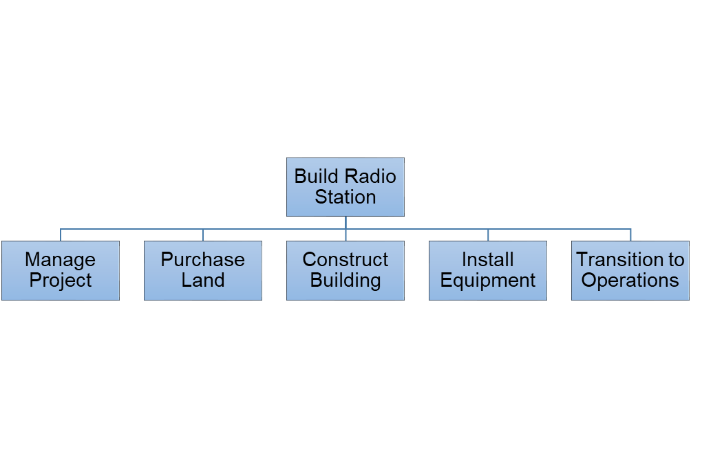
WBS/PBS Linkage
Radio Station Equipment
Broadcast
Radio
Antenna
Studio Equipment
Ancillary Equipment
Furniture
Computers & Comms
Power Supply
Generator
Racks & Cabling

Slide 41
Project Math 101
WBS + PBS = Project Scope

Slide 42
Project Math 101
WBS + PBS = Project Scope
What happens if the PM can’t allocate a requirement to the WBS or PBS?

Slide 43
WBS
PBS
How
Radio Station Equipment
Broadcast
Radio
Antenna
Studio Equipment
Ancillary Equipment
Furniture
Computers & Comms
Power Supply
Generator
Racks & Cabling
What
Project Scope should almost always be described in BOTH terms

Slide 44
WBS
Which comes first?
The Products?
Or the Work?
PBS
How
Radio Station Equipment
Broadcast
Radio
Antenna
Studio Equipment
Ancillary Equipment
Furniture
Computers & Comms
Power Supply
Generator
Racks & Cabling
What
Project Scope should almost always be described in BOTH terms

Slide 45
Product-Based Project Planning
Define and Analyze Products
Organize Work Packages
Prepare Estimates
Analyze Risks
Prepare Schedule
Prepare Budget
Document the Plan

Slide 46
Work-Based Project Planning
Define & Organize Necessary Work
Define Products & Allocate to Work
Prepare Estimates
Analyze Risks
Prepare Schedule
Prepare Budget
Document the Plan

Slide 47

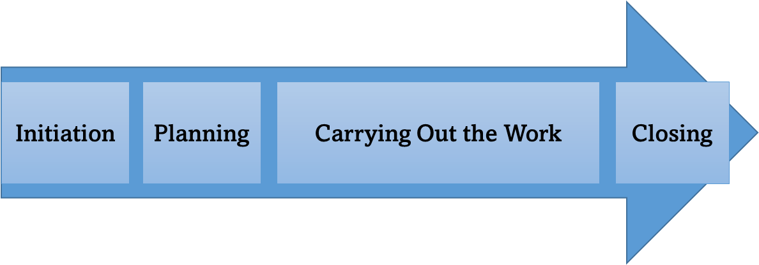
“Projects don’t GO wrong.
They START wrong.”

Slide 48
Back to the Triple Constraint
Time
Scope
Cost
If this increases
Then so must one or both of these
Scope Management Secrets: Day One

Slide 49
WBS Impacts on Schedule
Build Radio Station
Purchase Land
Manage Project
Construct Building
Install Equipment
Transition to Operations
Sequencing
Duration
Critical
Path

Slide 50
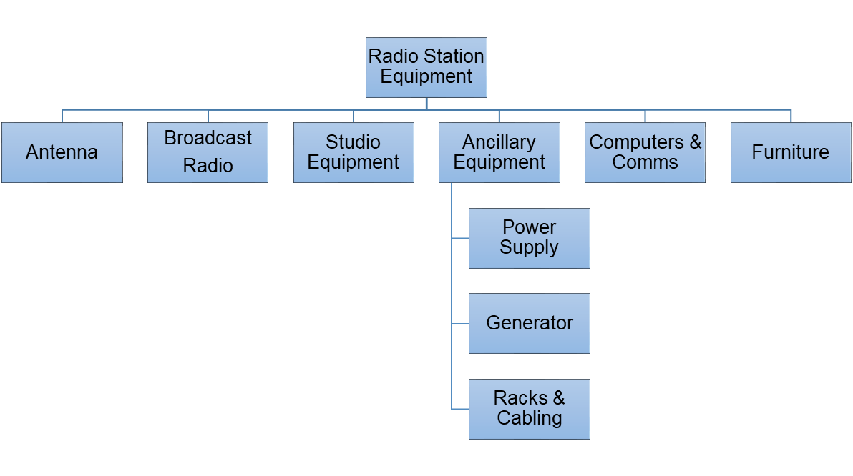
PBS Impacts on Schedule
Lead Time
Dependencies

Slide 51
WBS Impacts on Cost
Build Radio Station
Purchase Land
Manage Project
Construct Building
Install Equipment
Transition to Operations
Procurement
Costs
Activity &
Procurement
Costs
Activity &
Procurement
Costs
Activity
Costs

Slide 52
PBS Impacts on Costs
Procurement Costs
Procurement Costs
Procurement Costs
Procurement Costs
Procurement Costs
Procurement Costs

Slide 53
Impacts on Risk
WBS:
  Critical path
  Overruns in duration, activity cost
PBS:
  Interdependencies
  Overruns in cost, delivery time

Slide 54
Impacts on Stakeholder Engagement
WBS:
  Which stakeholders are involved?
  How they are involved?
  Is stakeholder engagement part of the WBS as a project management activity?
PBS:
  Producers/suppliers are stakeholders

Slide 55
Impacts on Change Management
WBS:
  Reflects the project approach: change friendly? Change averse?
  Changes in scope linked to WBS elements
PBS:
  Also reflects the project approach: is it locked in or flexible?

Slide 56
Scope Management: At the Heart
Cost
Management
Schedule
Management
Risk
Management
Integration
Management
Scope
Management
Resource
Management
Quality
Management
Communi-cations
Management
Procurement
Management
Stakeholder
Management

Slide 57
Key Concepts: Project Lifecycle
“Projects can range along a continuum from Predictive approaches at one end
to Adaptive or Agile approaches at the other.”

Slide 58
Predictive
Scope
Time
Cost
Determined early in the project
Baselined
Changes carefully managed

Slide 59
Iterative
Scope
Determined early in the project
Time
Cost
Modified as understanding of the product increases

Slide 60
Agile
Time
Cost
Increments (sprints) of work
Scope
Which deliver and clarify

Slide 61
Scope Management Process
Plan Scope Management
Collect Requirements
Define Scope
Create WBS (and PBS!)
Validate Scope
Control Scope

Slide 62
Scope Management Process
Planning
Plan Scope Management
Collect Requirements
Define Scope
Create WBS
Validate Scope
Control Scope
Monitoring & Controlling

Slide 63
Key Inputs
Project Charter
Project Documentation
  Assumption Log
  Risks Register
  Stakeholder Register
Project Management Plan
Enterprise Environment Factors
Organizational Process Assets

Slide 64
Key Outputs
Scope Management Plan
WBS
Requirements Documents
Inputs to Assumptions Log
Inputs to Stakeholder Register
Change Requests

Slide 65
Tailoring Considerations
Knowledge Management
Requirements Management
Validation
Control
Development Approach
Stability of Requirements
Governance

Slide 66
Scope Management Plan
Preparing the Scope Statement
Creating the WBS
Scope Baseline approval and maintenance
Formal acceptance

Slide 67
Requirements Management Plan
Collection
Analysis
Tracking
Prioritization
Traceability
Change management
Reporting

Slide 68
Scope Management
Plan
Scope
Management
Create
WBS
Control
Scope
Collect
Requirements
Define
Scope
Validate
Scope
Scope Management Secrets: Day One

Slide 69

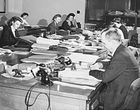

The Relocation Project
Accounting
Human Resources
New Location

Slide 70
Exercise #1: Defining Scope
You are the PM for the Relocation Project.
Prepare an initial Project Scope Statement:
  Work Breakdown Structure
  Product Breakdown Structure
  List of Planning Assumptions

Slide 71
SCOPE MANAGEMENT:
The Not-So Basics
WHY SCOPE IS COMPLEX

Slide 72
The Project Life Cycle
Initiation
Planning
Carrying Out the Work
Closing

Slide 73
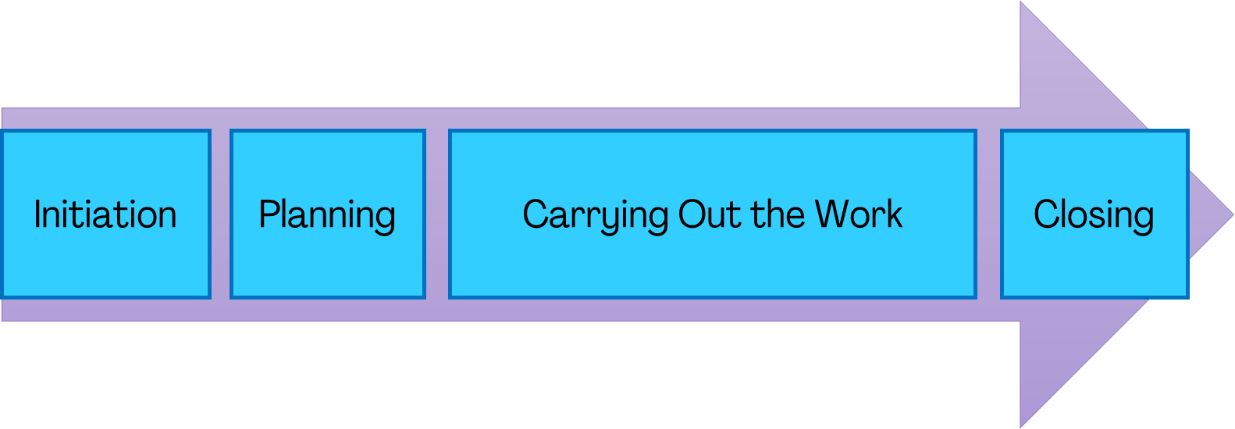
The Larger Life Cycle
What Happened in the Past
What Led to Project Initiation
What is Going On During the Project
What will Happen After the Project

Slide 74
Project as Change Delivery
Organizational Strategy
New Business as Usual
Project
Business as Usual

Slide 75
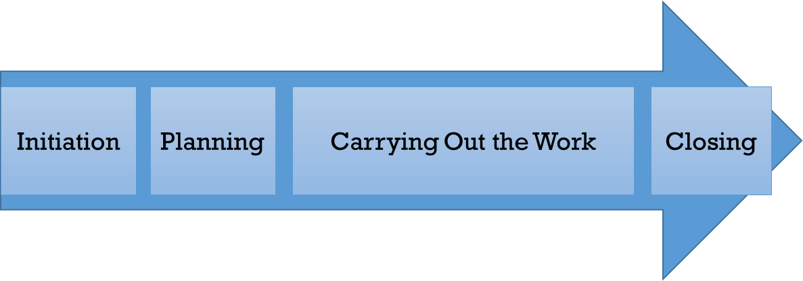
The Larger Life Cycle
What Happened in the Past
What Led to Project Initiation
What is Going On During the Project
What will Happen After the Project
Enterprise Environmental Factors
  Organizational culture
  Infrastructure
  Personnel
  Market Forces
  Regulations
  Organizational Process Assets

Slide 76

What is the Project’s Why?
Why are we doing this?

Slide 77

“If you don't know
where you are going,
you'll end up
someplace else.”

Slide 78
Project Initiation Context
Regulatory/Legal/
Social Requirements
Stakeholder Needs
One or More of These is the Source of the Project’s WHY
Create New Products, Processes or Services
Upgrade/Improve/
Refresh Existing Capabilities
Transformational Change

Slide 79
The Basic “Why” Model
Projects deliver outputs
The outputs enable outcomes
The outcomes realize benefits
The benefits achieve strategic objectives

Slide 80
A Benefits Model
Radio
Station
Improved
Public
Communication
More Stable Public Security
Project
Delivers
Output
Outcome
Benefit
Enables
Realizes

Slide 81


Outputs versus Benefits
1903
2003
Output
Benefits

Slide 82

Two ways to see the project

Slide 83
Looking forward:
What has to be done?
What has to be delivered?
The PM’s View

Slide 84
Looking backward:
What have been the outcomes?
What have been the benefits?
The Sponsor’s View

Slide 85

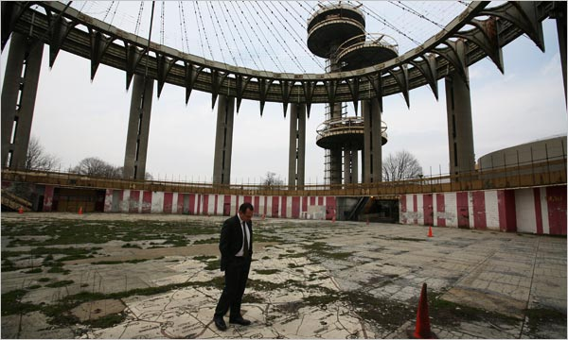
How Time Can Affect Scope
By What Timeframe
will the
Project be Judged?
1964
Short Term?
2014
Or Long Term?

Slide 86
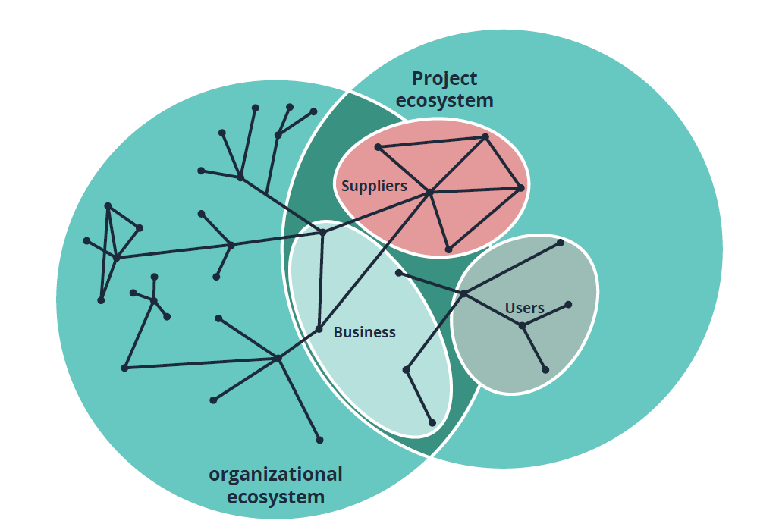
Ecosystems and Interests

Slide 87
Scoping the Scope
How can you plan Scope Management if any of the following are missing from the Project Charter?
  Purpose
  Measurable Objectives and Success Criteria
  High-level project description, boundaries, and key deliverables
  Project approval criteria (e.g, what constitutes project success)?

Slide 88
Scope in the Project Charter
“The Scope section addresses the Who, What,
Where, When, and Why of a project.”*
*Most of the Project Charter templates you will find on the Internet

Slide 89
Scope in the Project Charter
“The Scope section addresses the Who, What,
Where, When, and Why of a project.”*
And the How!
*Most of the Project Charter templates you will find on the Internet

Slide 90
Work Scope vs. Product Scope
The WBS (the “How” of Delivery)
The PBS (the “What” of Outputs)

Slide 91
Work Aspects: Change Approach
Green Field?
  Little or no existing infrastructure, least impact on current operations
Upgrade/Improvement?
  Backwards compatibility, synchronization with existing operations, before/after comparisons
Transformational?
  Transition from “As Is” to “To Be,” slack in transforming workforce, before/after comparisons

Slide 92
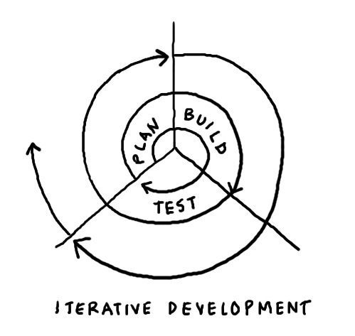
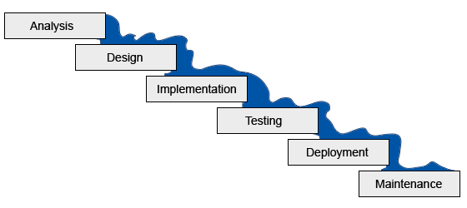
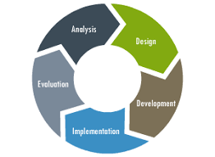
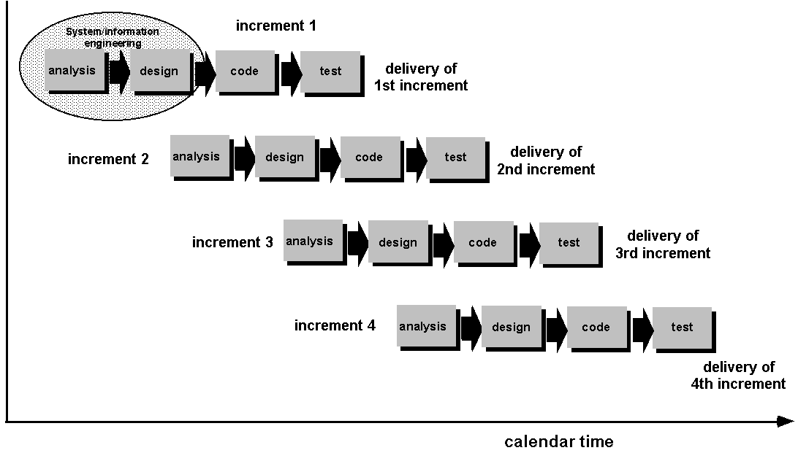
Work Aspects: Project Lifecycle

Slide 93
Work Aspects: Project Model
Each Model carries Assumptions and Constraints for both the WBS and the PBS

Slide 94
Adaptive/Agile/Incremental
How will the approach be reflected in the Work Breakdown Structure?
Or will the WBS (and PBS?) be updated and re-baselined repeatedly?
Are prototypes and other interim deliverables also part of the Product Breakdown Structure?

Slide 95
Project team
Aspects to consider:
  Co-located? Dispersed? Virtual?
  Do they share a common language? Culture? Time Zone?
  What is the level of commitment of team members?
  What are their Priorities? Constraints?
  What is their level of authority?
  What is their level of expertise/experience?

Slide 96
Sourcing/Procurement
Sourcing Decisions:
  In-house? • Equipment?
  Outsourced? • Services?
  Mix? • Mix?
Very often, procurement must be included as part of the WBS
  But procurement approach can also influence the PBS

Slide 97
Contractors as part of the project team
How are they contributing?
  As suppliers?
  As developers?
  As producers?
  As integrators?
  As workforce capacity?
  As consultants/subject matter experts?
  Onsite? Offsite?
  Some or all of the above?
Scope Management Secrets: Day One

Slide 98
Transition/Handover
Tied to the change model (e.g., Green Field)
Transition impacts on WBS (and PBS?):
  Workforce training/retraining
  New/adapted procedures
  Parallel operation (old/new)
  Fallback option
  Initial operational support

Slide 99
Product Aspects
PBS and its components
  Sourcing
  Buy? Assemble? Develop? Integrate?

Slide 100
Individual Product Requirements
Physical Scope
Quality
Control requirements
Acceptance criteria

Slide 101
Defining the Outputs/Deliverables
Production outputs
  What most customers consider outputs:
  the things they will use
Management outputs
  What are needed to plan, monitor, and control the project

Slide 102
Physical scope
Quantity
Size
Capacity
Location

Slide 103
Quality
Functional requirements
    What the product needs to do
Nonfunctional requirements
    What the product needs to be
    Often referred to as the “ilities”
      Reliability
      Availability
      Maintainability

Slide 104
Product control requirements
Design/development/production checkpoints
Inspection
Testing
Inventory

Slide 105
Acceptance criteria
A key link to the WBS
Who accepts?
What?
When?
Where?
How?

Slide 106
Other Aspects of Scope
Boundaries
Constraints
Sustainability
Change Appetite
Volatility (e.g.,Market, Organization, Technology)
Time

Slide 107

Boundaries
Where does the project stop?
If You Know What’s In Scope
You Should Be Able to Tell What’s
Out of Scope

Slide 108
Constraints
Authority
  What Project Manager has authority to decide
Legal
  What means are considered legal?
Regulatory
  Are there health and safety constraints?
Interfaces
  Do the products have to work with other systems?
Policy
  Are there policy constraints on how the work is done?
Operational
  Are there constraints on disrupting running operations?

Slide 109

Sustainability

Slide 110
Governance
Who/What does the Project Manager report to?
  Internal Project Management
  Project Board
  Project Sponsor
  Program Management Office
  Corporate Board or Committee
  Public Board or Committee
Are there any back-channels? Do they matter?

Slide 111
Program management/PMO
Is the project part of a program?
How that impacts scope
  As an enabler
  As a constraint

Slide 112
Decision Making
Who can approve changes to:
  Project Scope Baseline?
  Contracts and Agreements?
  Project Budget?
  Project Schedule?
And how fast do these processes work?

Slide 113
Volatility
How susceptible is the project to:
  Change from within the project?
  Change from outside the project?

Slide 114
Change Appetite
Open to Experimentation
Leaning Forward
High
What Can the Project
Expect To Encounter?
Readiness
Resistance
&
Inertia
“The Spirit is Willing but the Flesh is Weak”
Low
Low
High
Urgency

Slide 115

What is the Appetite for Change?
Change?
Scope Management Secrets

Slide 116
Importance of a Holding Space
Early in the Project Life Cycle, it’s not always clear what’s In Scope and Out of Scope
Deciding too early can lead to problems with Planning, Execution and Acceptance
Provide a space to hold what’s in doubt
    This can be one function of the Issue Log

Slide 117
Baselining Scope
As part of Project Management Plan approval,
its Scope should be baselined:
  WBS
  PBS
  Requirements Documents
This is key to enable Change Management and Reporting

Slide 118

Baselining: Establishing Controls
In Scope
Not in Scope

Slide 119
Group Exercise #2: Revising Scope
In light of the preceding discussion, how should we revise the Initial Project Scope Statement for the Relocation Project?
Do we need to make changes in:
  The Work Breakdown Structure to the first level (major activities)?
  The Product Breakdown Structure?
  The list of planning assumptions?
Is there anything we should place into a Holding Space such as the Issue Log?

Slide 120
SCOPE MANAGEMENT:
The NOT-So BASICS
WHY SCOPE IS FUZZY

Slide 121
Time is Easy to Measure
Start
Finish
Planned
200 days
Start
Finish
Actual
210 days
Early
Late
200 days

Slide 122
Cost is Easy to Measure
Over
$225,000
$200,000
$200,000
Under
Planned
Actual
Scope Management Secrets: Day One

Slide 123
Scope?
Over
???
Under
What number would apply?
Planned
Actual
There is no single measure for scope
Scope Management Secrets: Day One

Slide 124
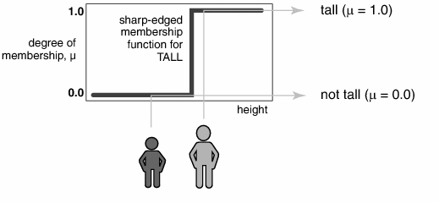
A Set with a Clear Boundary

Slide 125
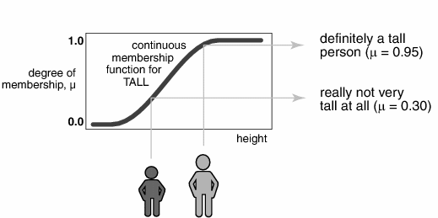
A Set with a Fuzzy Boundary

Slide 126


A Fuzzy Set: Tall Basketball Players
Dirk Nowitski
7 ft.
Manute Bol
7 ft. 7 in.
Jason Kidd
6 ft. 4in.
Josh Howard
6 ft. 7 in.
Muggsy Bogues
5 ft. 3 in.

Slide 127
Q: Where Do Requirements Come From?
A: Stakeholders!
This is why Stakeholder Identification and Analysis should be the first step in the process

Slide 128
Who’s a Stakeholder?
}
An individual, group, or organization that may be:
  Involved in
  Affected by
  Able to affect
  Have an interest in
  Have an opinion about
The Project
or
Its Outcomes

Slide 129
Stakeholders
Have an interest in or Opinion about
Are Affected By
Are Involved In
The Project Team

Slide 130
Stakeholder Analysis
Interests
Influence
Authority
Rights
Ownership
Knowledge
Contribution
Means to Communicate/Engage

Slide 131

Stakeholder Engagement
The Key is to Understand that Requirements Elicitation and Validation is a Social Activity
Participation Always Improves Buy-In

Slide 132
Stakeholder Engagement: Getting Buy-in
The impact of time/distance/commitment
Mitigating the risk of rejection
Never underestimate the value of spending long hours together
in conference rooms (or on Zoom)!

Slide 133

Collecting Requirements

Slide 134
Requirements Elicitation
Interviews
Role-Playing or Simulation
Brainstorming
Questionnaires
Focus Groups
Prototyping
Observation

Slide 135
The Challenge of Requirements Elicitation
The Stakeholder’s Perspective
The Project’s
Perspective
It is hard to find someone with 20/20 vision in both

Slide 136

What’s a Message?
Scope Management Secrets: Day One

Slide 137
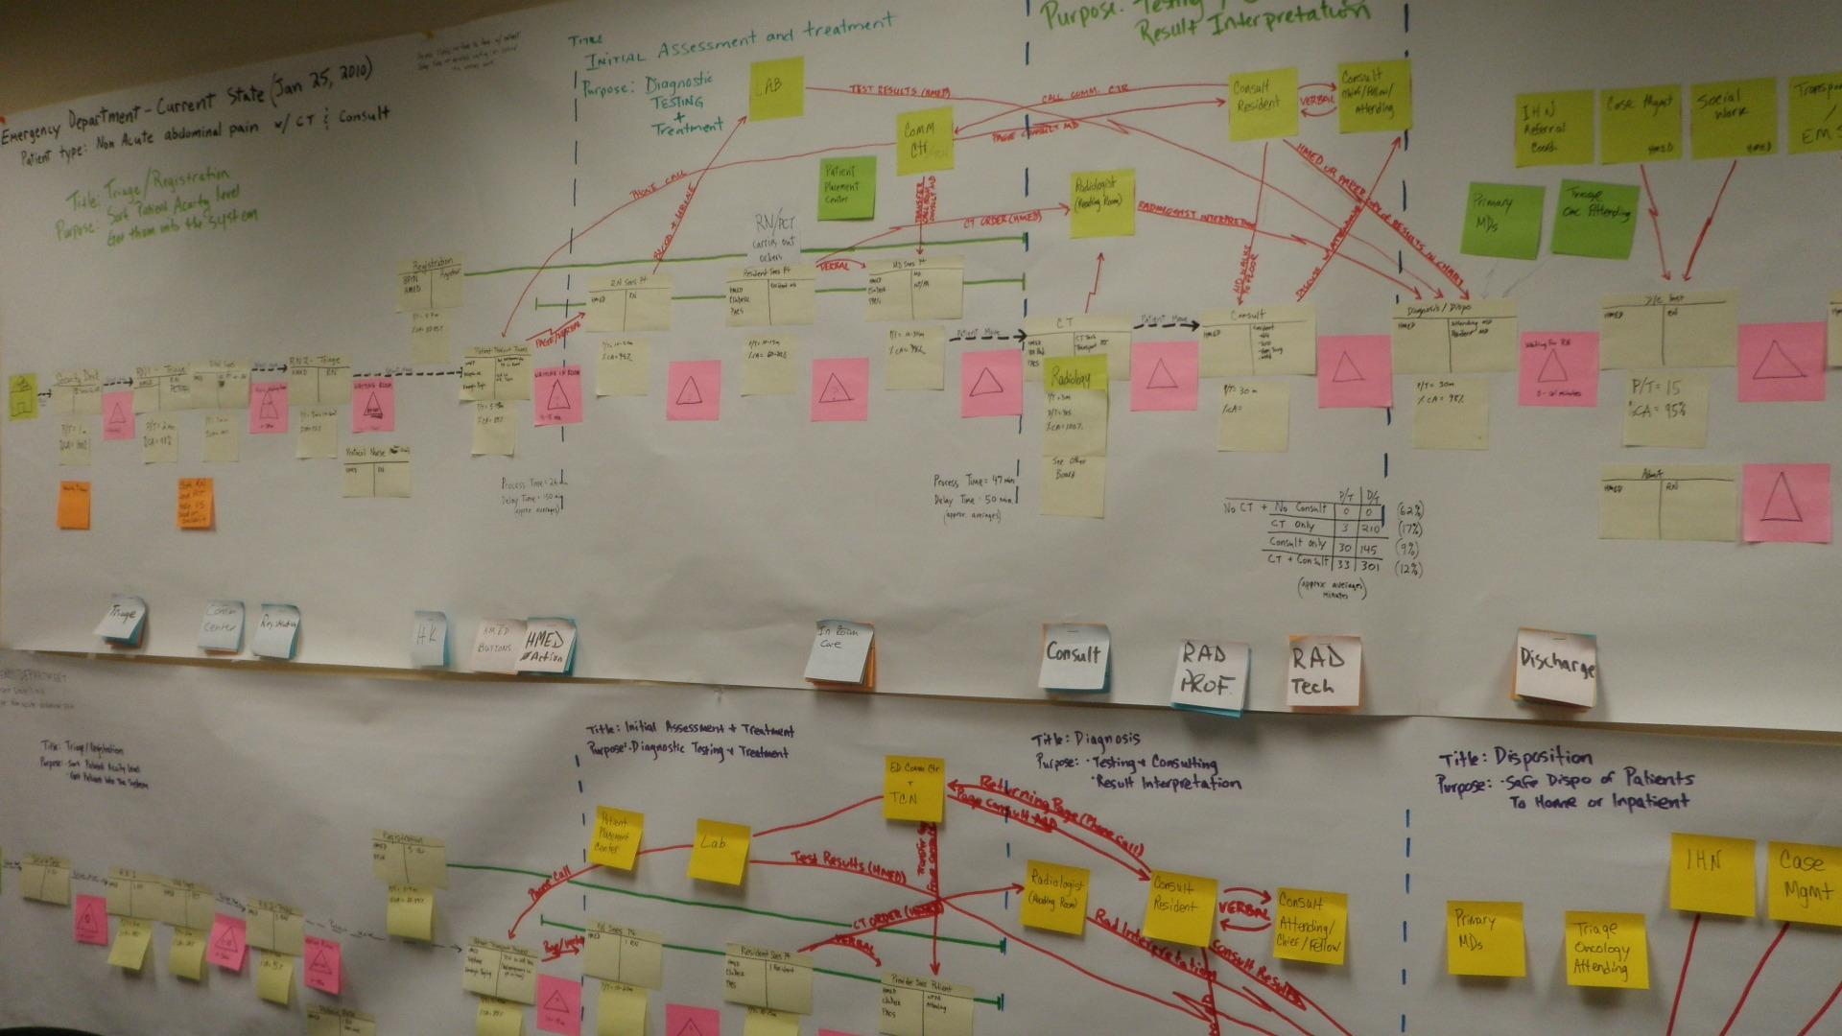
Requirements Elicitation
Never underestimate the value of a conference room wall covered in Post-It® notes!

Slide 138
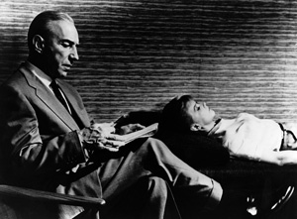
Requirements Elicitation/Collection
Elicitation often involves delving into the stakeholder’s unconscious:
  Expectations
  Assumptions
  Fears
  Opposition
Scope Management Secrets: Day One

Slide 139
Requirements Elicitation/Collection
In an Ideal World, Requirements would be delivered on a Silver Plate:
  SMART
  Complete
  Validated
  Owned
  Explicit
  Unambiguous

Slide 140
Requirements Elicitation/Collection
In the Real World, Requirements are rarely more than some of these:
  SMART
  Complete
  Validated
  Owned
  Explicit
  Unambiguous

Slide 141

Requirements Analysis
WBS
Elicitation& Collection
Allocate
PBS
System
Requirements Specification
Allocate
Analysis
Hold
Holding
Space
Rework
Reject

Slide 142
Requirements Validation
The Requirements Documentation is almost always assembled from the inputs of multiple stakeholders with varying interests
If possible, make sure someone takes ownership and validates the requirements
  Avoid the ugly “Who asked for this?” questions

Slide 143
Traceability: Deriving vs. Inventing
A few pages
25-50 pages
25-50 pages
10s to 100s of pages
10s to 1,000s of pages
Charter
Project Management Plan
Requirements Baseline (WBS, PBS)
Statements of Work
Product Specifications

Slide 144
Requirements quality control
The theory of SMART requirements
  Specific
  Measurable
  Attainable
  Relevant
  Timely
High Quality Requirements = High Quality Results

Slide 145
The reality of SMART requirements
The theory of SMART requirements
  Specific
  Measurable
  Attainable
  Relevant
  Timely
High Quality Requirements Do Not Guarantee High Quality Results
Quality Has a Cost
Few Projects Succeed in Obtaining SMART Requirements across the full project scope

Slide 146

Tom Gilb’s Challenge
“The Top 10 Critical
Requirements for any
project can be
identified and quantified
in a good day’s work—
and written down on a
single page.”
Scope Management Secrets: Day One

Slide 147
Group Exercise #3: Requirements
Identify one Top Ten Critical Requirement
Quantify it
Write it down in no more than 3 sentences
The Tom Gilb Challenge

Slide 148
Requirements Change Analysis
New Require-ment
WBS
Elicitation& Collection
Allocate
PBS
System
Requirements Specification
Allocate
Analysis
Hold
Holding
Space
Rework
Reject

Slide 149
The Integrated Project Baseline
Baseline Schedule
Time
Baseline Budget
Scope Baseline
Scope
Cost
If this increases
Then so must one or both of these

Slide 150
Change control
Change
Baseline Schedule
Time
Baseline Budget
Evaluate Changes in Terms of Changes to the Baselines
Scope Baseline
Scope
Cost
If this increases
Then so must one or both of these

Slide 151

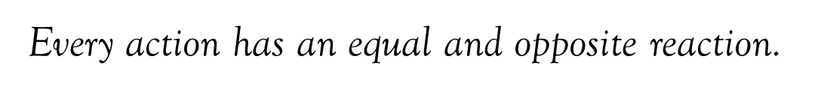
Third Law of Motion
Rejecting a change has a consequence.

Slide 152

What Happens to Change that Falls Out of Scope?
Scope Management Secrets: Day One

Slide 153

How do you deal with project change?

Slide 154
SCOPE MANAGEMENT:
The NOT-So BASICS
WHY SCOPE IS RISKY

Slide 155

I predict that people will continue to be terrible at making predictions.
Scope Management Secrets: Day One

Slide 156
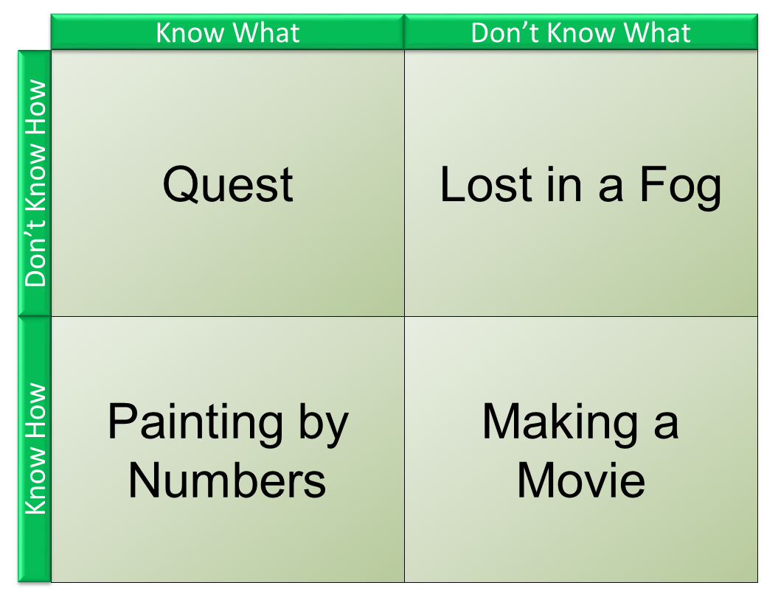
Know What/Know How Matrix
Scope Management Secrets: Day One

Slide 157
Know What/Know How Matrix
Product Immaturity

Slide 158
Know What/Know How Matrix
Process (Work) Immaturity

Slide 159
Maturity
Have we done this type of work before?
Have we dealt with this type of product before?
If not … Is there anyone we can copy learn from?

Slide 160
Q:
How does know how/know what maturity affect your projects?
Scope Management Secrets: Day One

Slide 161
Uncertainty
Known
Unknowns
Unknown
Unknowns
Known
Knowns
Unknown
Knowns

Slide 162
Uncertainty: Explicit and Implicit
Explicit:
  Whatever is not stated must therefore be uncertain
Implicit:
  Whatever is stated imprecisely or unclearly must therefore incorporate some uncertainty

Slide 163
Impact of Duration
Planning
Completion
Scope Management Secrets: Day One

Slide 164
Impact of Duration
Planning
Completion
Scope Management Secrets: Day One

Slide 165

Cognitive Biases
Groupthink
Overconfidence
Selective Perception
Sunk Cost
Illusion of Control
Available Data

Slide 166

Cognitive Biases
Humans tend to be overly optimistic about future benefits
Humans tend to be overly pessimistic about future losses
The farther away the target, the greater this effect can be seen

Slide 167
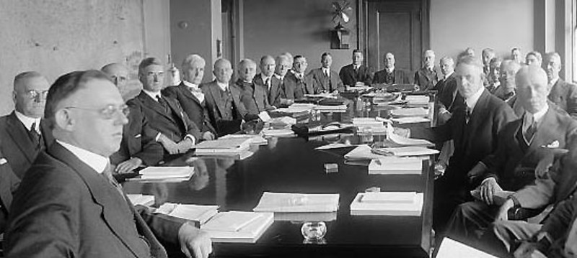

Organizational Culture
Informal and Cooperative?
Formal and Hierarchical?
Scope Management Secrets: Day One

Slide 168
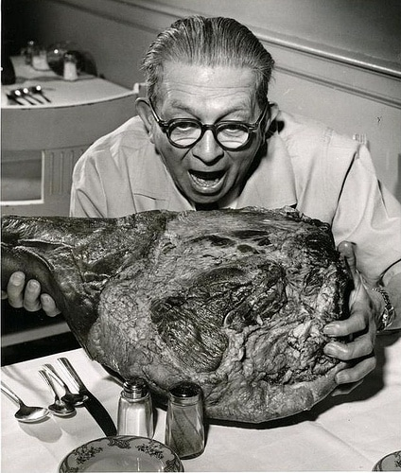
Risk Appetite
Scope Management Secrets: Day One

Slide 169

Elephants and Risks
Just pretend I’m not here.

Slide 170
Elephants and Risks
Inertia
Ownership
Denial
Influence
Wishfulness
Overconfidence
“Let Sleeping Elephants Lie”
“It’s not MY Elephant!”
“What Elephant?”
“The Boss Says There’s No Elephant”
“Maybe the Elephant Will Just Go Away”
“This isn’t an Elephant: It’s an Opportunity!”
Courtesy of Kailash Awati, https://eight2late.wordpress.com/

Slide 171
Group Exercise #4: Scope Risks and Responses
Think about the Relocation Project:
  Identify two High Risks of Uncertainty or Scope Change
  Propose two Responses or Ways to Mitigate each

Slide 172
The Cone of Uncertainty
Too High
Estimation
Uncertainty
Too Low
Initiating
Planning
Executing
Acceptance

Slide 173
All Estimates are Uncertain
Lack of adequate data
Inappropriate comparisons
Misjudged parameters
Missing elements
False precision
Mandated by decree
This is why professional estimates come with confidence levels or margins of error
Scope Management Secrets: Day One

Slide 174
The Cone of Uncertainty
Too High
Estimation
Uncertainty
Margin of Error
Too Low
Initiating
Planning
Executing
Acceptance

Slide 175
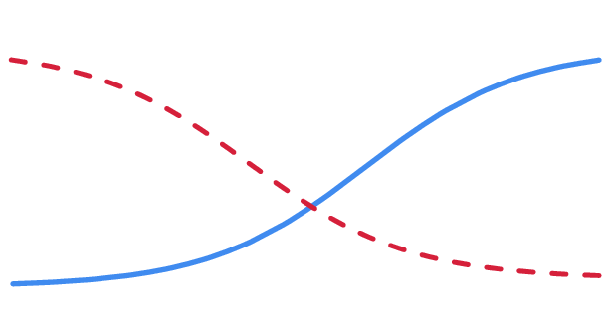
Risk & Cost of Change over Time: Theory
Risk
Cost of Changes
Time

Slide 176
Risk & Cost of Change: Reality
Project
Baselined
Risk
Cost of Changes
Time

Slide 177
Dealing with uncertainty
Define it out—or define it in
Plan it out—or plan it in
Reduce it incrementally
Reduce it agilely
Eliminate it through renegotiation
Ignore it and hope for the best …

Slide 178
Mitigation measures:
Estimates with confidence levels/margins of error
Contingency budget
Change budget
Tolerances
Costed Risks
Adaptive Life Cycle
Rolling Backlog
Scope Holding Pen
Most Important of All:
Constant
Communication!

Slide 179
Mitigating Risk & Cost of Change
Trade Space
Sponsor’s Reserve
Project
Baselined
PM’s Reserve
Risk
Cost of Changes
Approved Change Budget
Approved &
Allocated Budget
Time

Slide 180
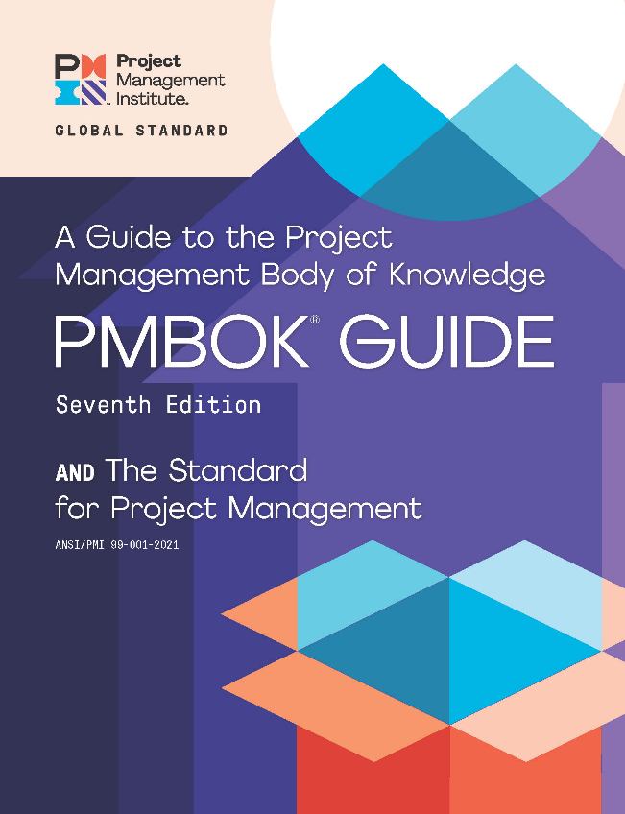
Project Management 101
“A project is a temporary endeavor undertaken to create a unique
product, service, or result.”

Slide 181

So, projects are all about deliverables, right?

Slide 182
The Basic “Why” Model
Projects deliver outputs
The outputs create results
The results realize benefits
The benefits achieve strategic objectives

Slide 183

Managing Successful Programmes

Slide 184
Managing Successful Programmes
Delivering the Change

Slide 185
Managing Successful Programmes
Delivering the Change
Embedding the Change

Slide 186
Project as Change Delivery
Organizational Strategy
New Business as Usual
Project
Business as Usual

Slide 187
Project
Delivering the Change
After the Project
Embedding the Change
Project
Relocated
Reduced O&M
Increased
Proficts
Output
Result
Benefit

Slide 188
Is the Project Life Cycle Too Short?
Project
Delivering the Change
After the Project
Embedding the Change
Project
Relocated
Reduced O&M
Increased
Proficts
Output
Result
Benefit

Slide 189
Or Are We Just Missing the Links?
Project
Delivering the Change
After the Project
Embedding the Change
Project
Relocated
Reduced O&M
Increased
Proficts
Output
Outcome
Benefit

Slide 190

Example:
A New Cultural Center

Slide 191

Is this the End of the Project?

Slide 192
Or the Start of the Outcomes?

Slide 193

Years Later ….

Slide 194
Delivering the Change…

Slide 195
Delivering the Change…
Vs. Embedding the Change

Slide 196
Results Are What’s Created When the Change Has Been Embedded
Outputs
Outcomes
Benefits

Slide 197
How Can Projects Help to Embed the Change?

Slide 198
So, projects are all about deliverables, right?
Outcomes

Slide 199
Translating Outcomes Into Outputs
Doctrine
Organization
Training
Material
Logistics
Personnel
Facilities
DOTMLPF
Used by US Military and NATO

Slide 200
Translating Outcomes Into Outputs
Process
Organization
Technology
Information
POTI
Used in ITIL and Managing Successful Programmes

Slide 201
Q: When is a Project Done?
A:
When its deliverables have created Outcomes!

Slide 202
Day One Lessons Identified Discussion
What have you found useful?
What can you take away to use on your projects?
Are there any topics we need to deep-dive into?

Slide 203

Questions?
Scope Management Secrets: Day One

Slide 204

THANK YOU!
PMI is interested in hearing about your PMI Training experience!
Your input is extremely important in helping us to continuously improve our program.
An email will be sent to you at 3:00pm local time on the last day of your training. The email will come from events@pmi.org
Class time will be provided to allow you to respond.
The survey will take approximately 10 minutes to complete.
Notes:
Instructor Note - **PLEASE DO NOT REMOVE THIS SLIDE. THIS IS A REQUIRED SLIDE.**
Instructor Note – Your onsite meeting planner sends this at 3pm the last (or only) day of your training. Please allow time for attendees to complete as the evaluation will provide feedback on their experience in your training.

